Slide 1
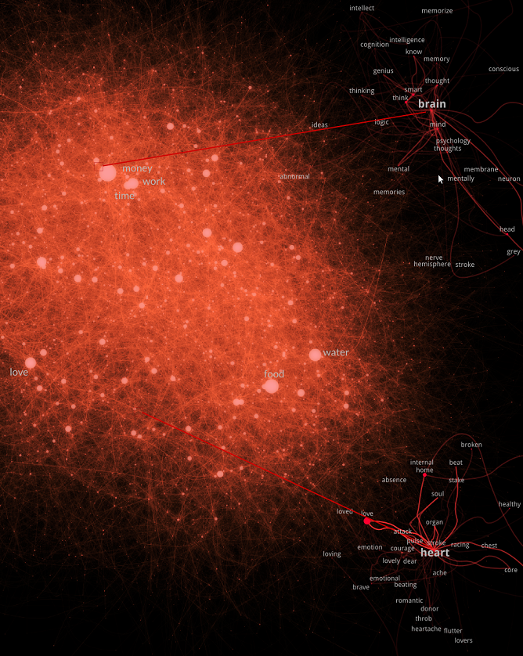


Multi-scale Semantic Network Analysis
Innovative Tools in the Study of Language Workshop Padua - 2021
Simon De Deyne
School of Psychological Sciences
simon.dedeyne@unimelb.edu.au

Slide 2
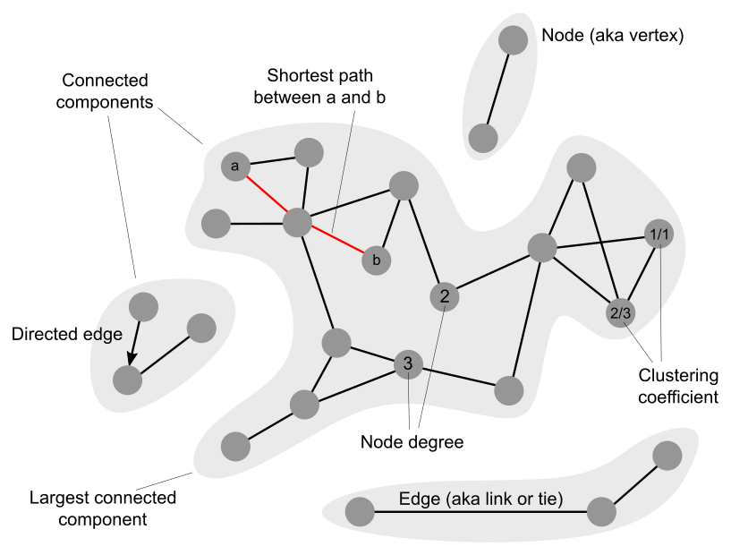
Network Measures
Notes:
A network or graph consists of a collection of nodes and edges.
The edges are either directed or undirected and can be weighted or binary
How can we characterize connectivity at various levels?
at local level of a node, describe how connected a node is
at global level a network might consist of multiple components, with typically one being the largest and a few satelites
We can easily think of language as a network because of its symbolic and relational nature, network show us the bigger picture

Slide 3
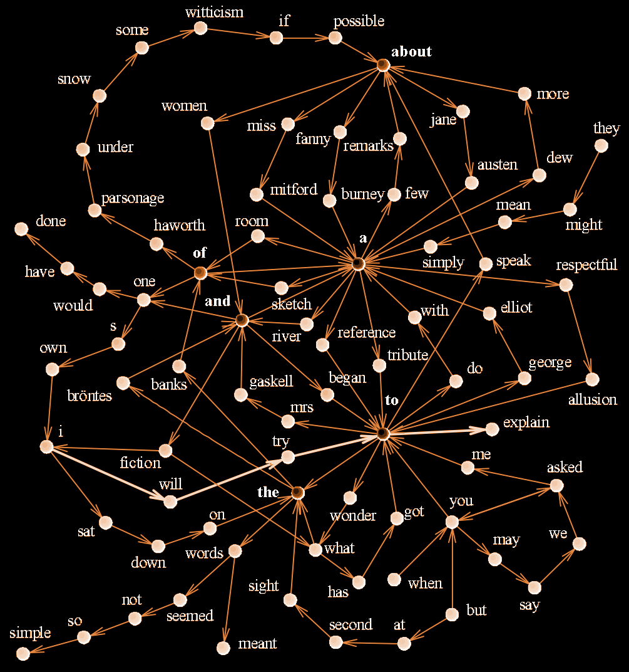
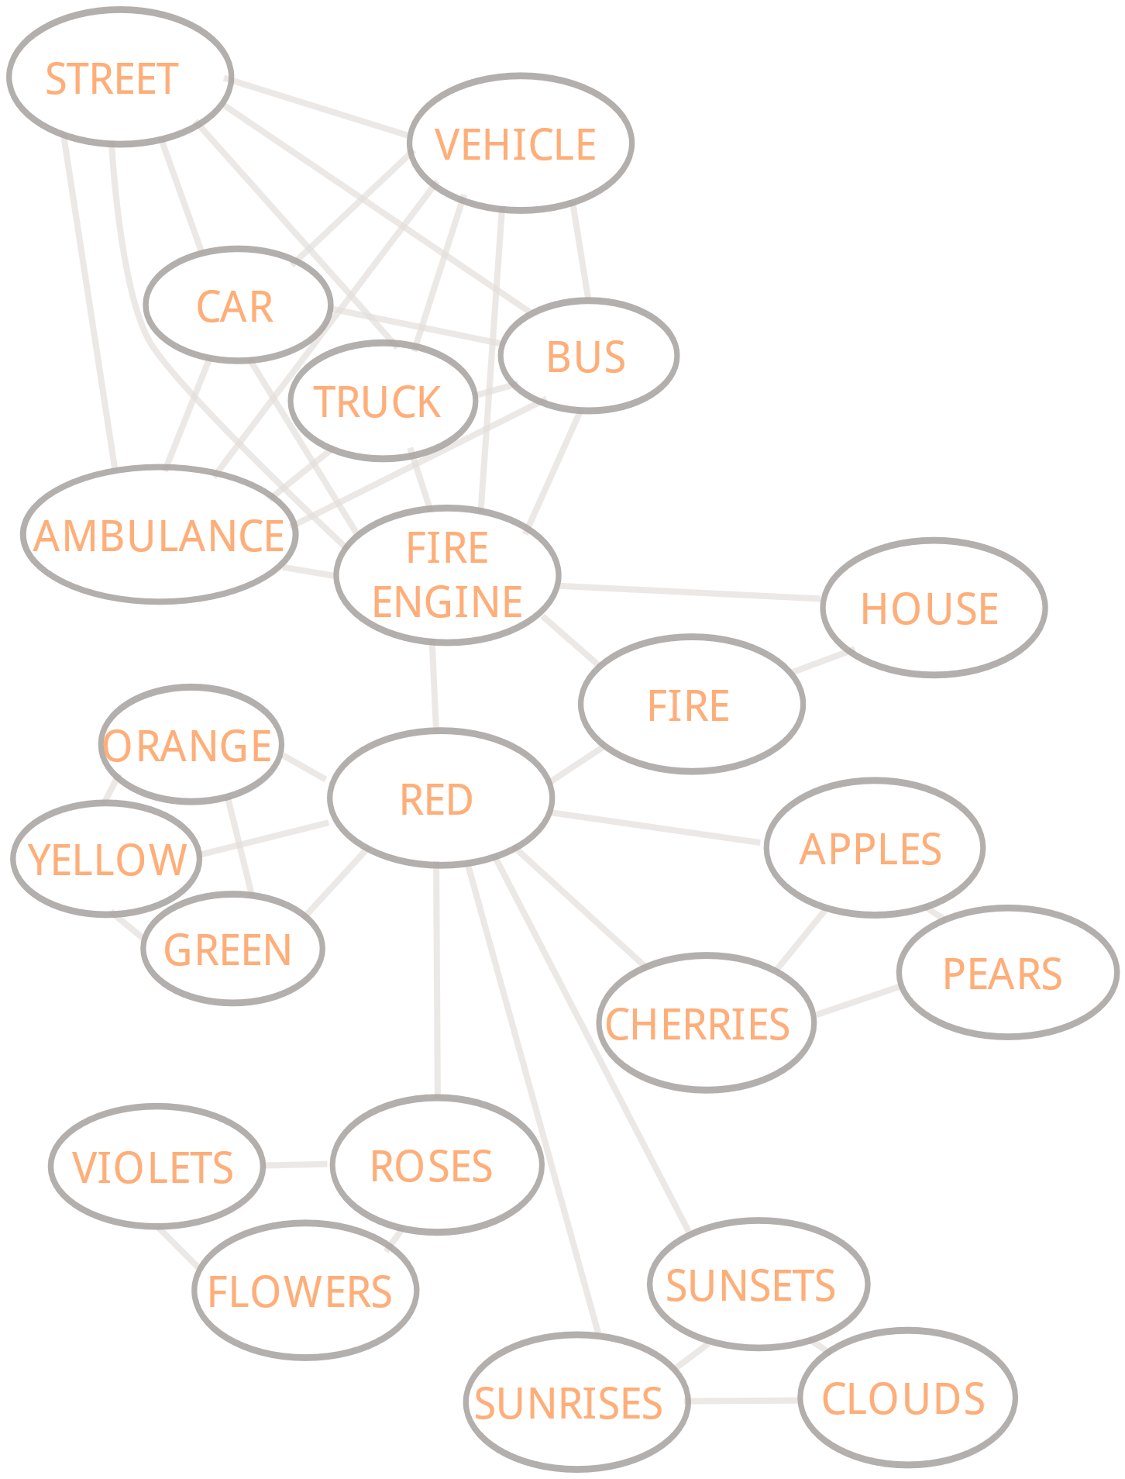
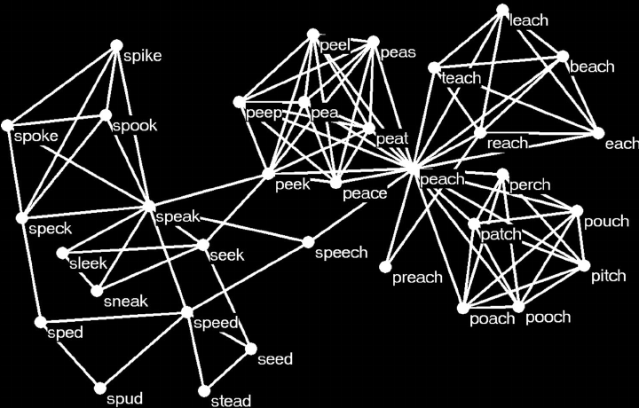
Language Networks
Co-occurrence
Semantic
Structure can be studied simultaneously at different levels
Phonological
Notes:
There are many different kind of language networks
Semantic networks: word meaning by traversing a semantic graph (Collins & Loftus, 1975)
Co-occurrence, precedence or syntactic networks Sole et al, (2010)
Phonological networks (Vitevitch, XXX)

Slide 4
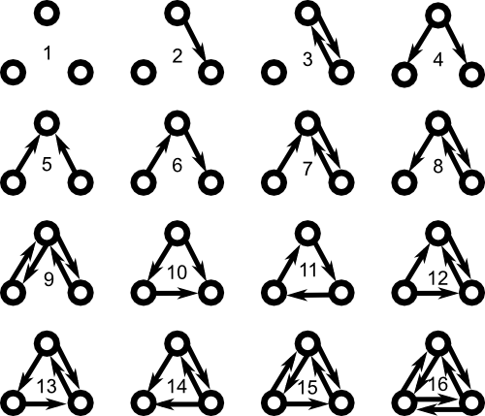
Microscopic structure
Centrality
Concrete words have “lower degree” than abstract words
Dense phonological neighbourhoods, affect lexical retrieval times
hubs
betweenness
degree
transitivity
Motives
Classify different language networks based on their motive signatures (Biemann, et al. 2016)
Notes:
The number of in or outgoing links determines the centrality of a node. Some nodes have neighbors that are also densily connected, leading to high clustering or transitivity. Many nodes in language occur more frequently than you’d expect and nodes can also be central because they lay on many different paths.
Moving from one to a few nodes, you can study motives in a network
Can also be used to evaluation n-gram language models, and see if they capture polysemy or synonomy corresponding
to those by similar degrees

Slide 5
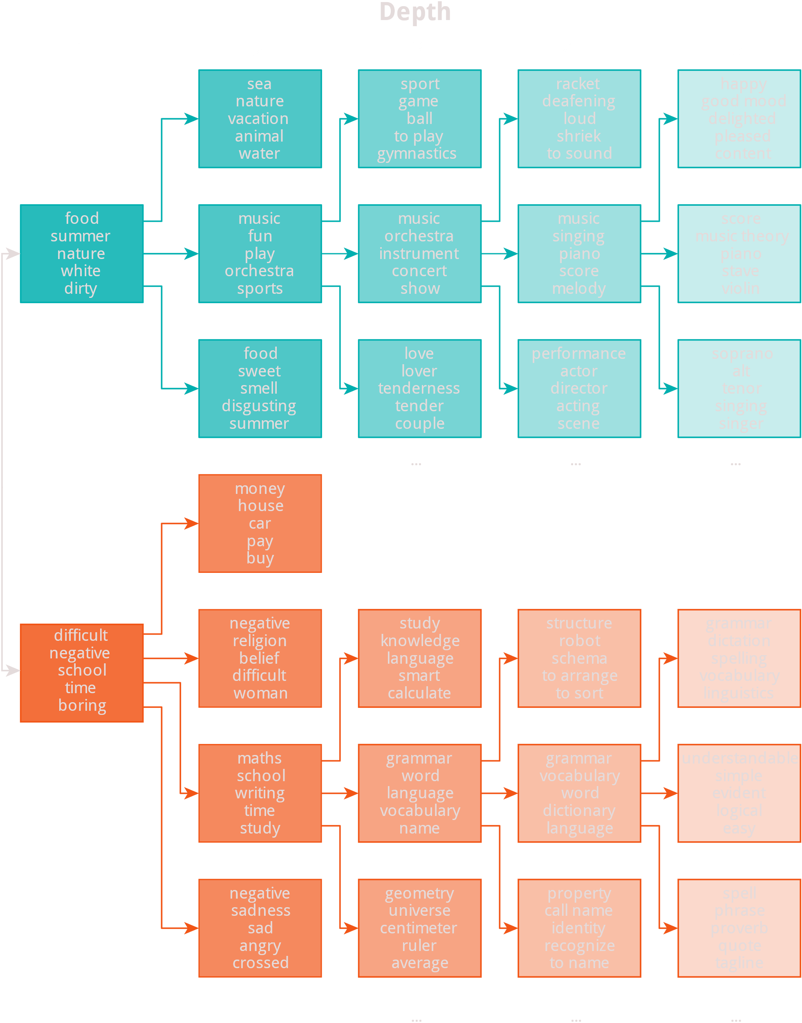
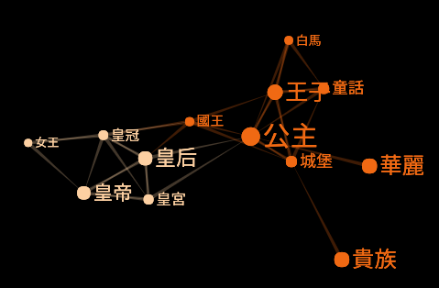
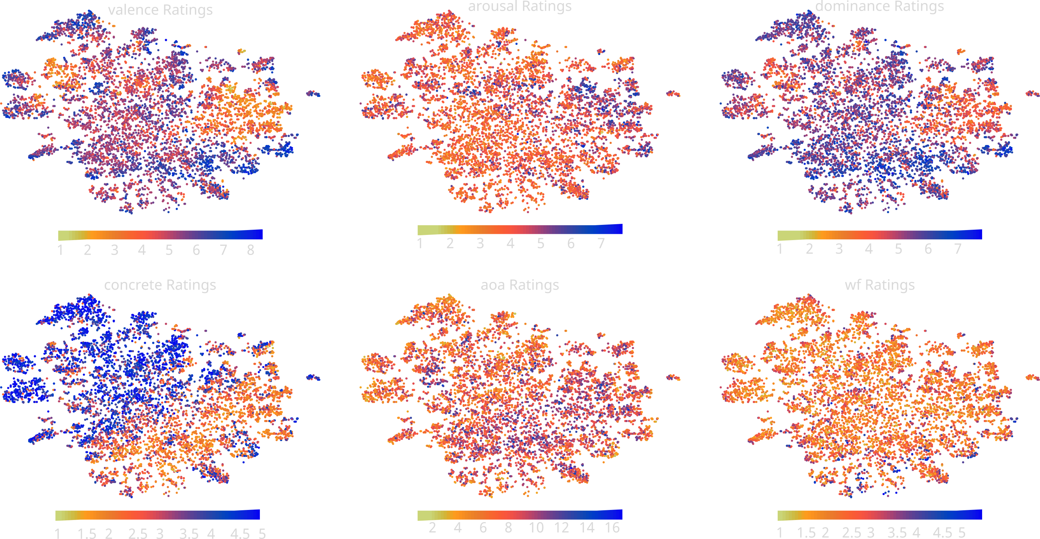
Mesoscopic structure
Notes:
At intermediate we’re interested in a group of nodes, often called communities.
Derive communities by identifying highly connected regions in the graph
Consider special roles nodes have in this community.
Polysemous word might connect two otherwise unrelated communities.
Prototypical word as being central in terms of the number of connects
Group clusters in larger units to derive hierarchies
At this level, we start seeing how local structure affects all other levels.
Assortativity effect. Words that have different POS might be connected, but in other studies, we found that participants mostly give words that are as abstract or as concrete as a response. This allowed us to identify emotional valence and concreteness to be the determing factors in the lexicon.
What’s special about the mesoscopic lexicon, is that it’s transparent, we can see how central nodes are in the cluster, and how they’re related to others and read this picture immediately.

Slide 6
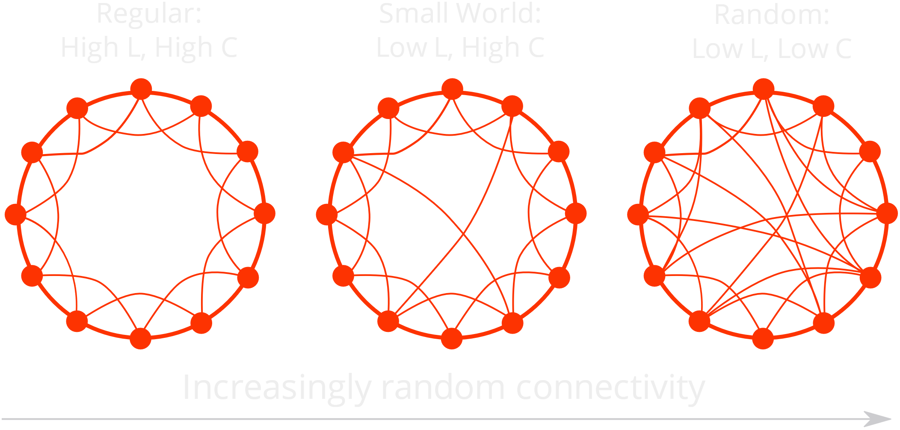
Macroscopic structure
Small World Scale-Free Networks
Short Average Path length (L)
High Clustering (C)
Hubs: (good, bad, woman, old)
Scale-free: degree distribution = power law
Highly navigable structure, robustness to random failure
Common in many naturally evolving systems
Possible mechanism: Preferential Attachment (Steyvers & Tenenbaum , 2014)
Notes:
At the macroscopic level: the question how network is described as a whole
One special type of network is a small world network (between regular lattice and random network)
Scale-free networks: more highly connected nodes than a comparable random network
Hubs are highly connected nodes, and in small networks there’s an overabundance of them
Semantic networks, the hubs would good, bad woman,old
Global structure also tells you something about resilience and efficiency of processes operating on the graph

Slide 7
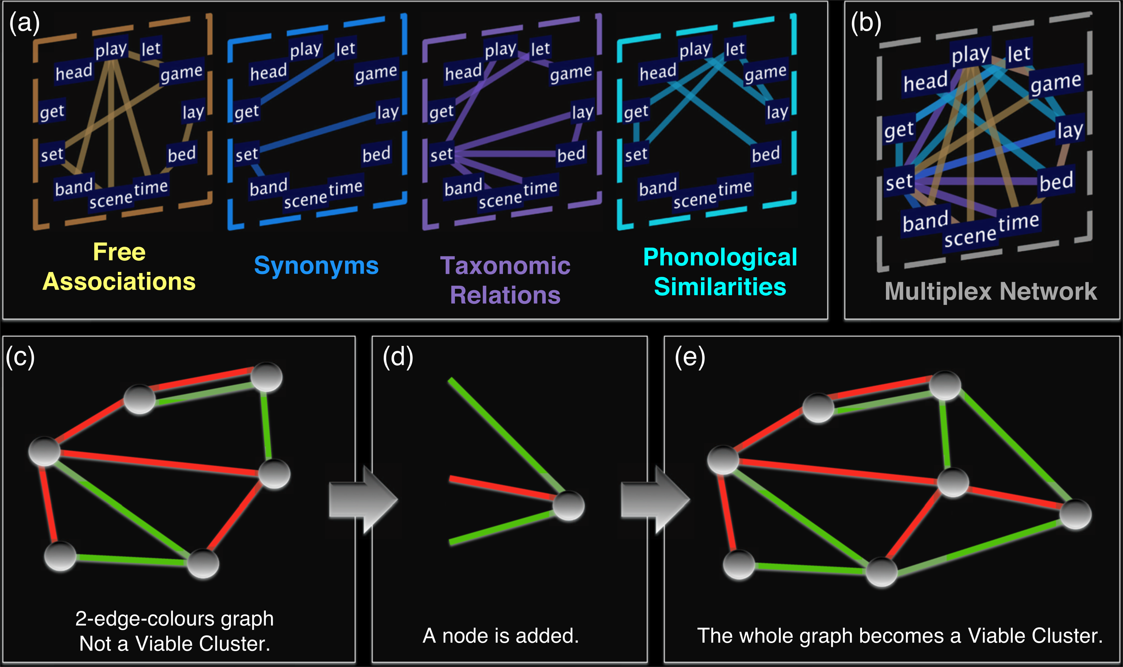
Multilevel analysis – Multiplex graphs
Explosive language learning in humans (Stella et al., Scientific Reports, 2018).
Idea:
Manipulate presence of links according to age-of-acquisition
What determines tipping points in connectivity ?
Notes:
Most interesting case: multilevel analysis with multiplex graphs
Study about language development where they account for a cluster of words that are highly frequent, learned more easily and with more meanings than what you’d expect in a random reference graph.
Manipulating the presence of links they established that this cluster emerges around age 7, and find that polysemy plays a big role in this.
Complexity through interaction at different layers
Cf. Multiplex networks for phonology and meaning: emergence of largest connected component: when? special role of homonyms? etc.
Briefly, networks provide a framework to investigate structure simultaneously combining different aspects of language

Slide 8
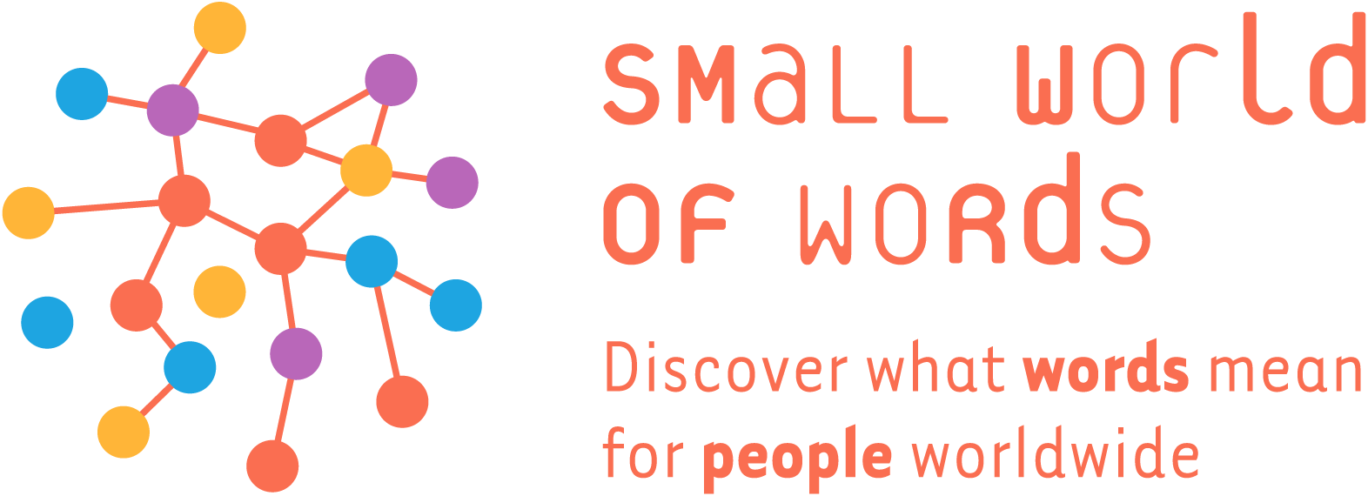
Small World of Words project
Build a realistic approximation of the mental lexicon in major world languages
De Deyne & Storms, 2008, De Deyne et al., 2013; De Deyne et al. (2019)
Notes:
Ongoing project
+ 300,000 participants
13 languages, mainly English, Dutch, Mandarin and Spanish
Sameness, or similarity or relatedness are one of the most fundamental properties in cognition and here I will look at this from a network perspective, considering the paths that might connect any pair of nodes.

Slide 9
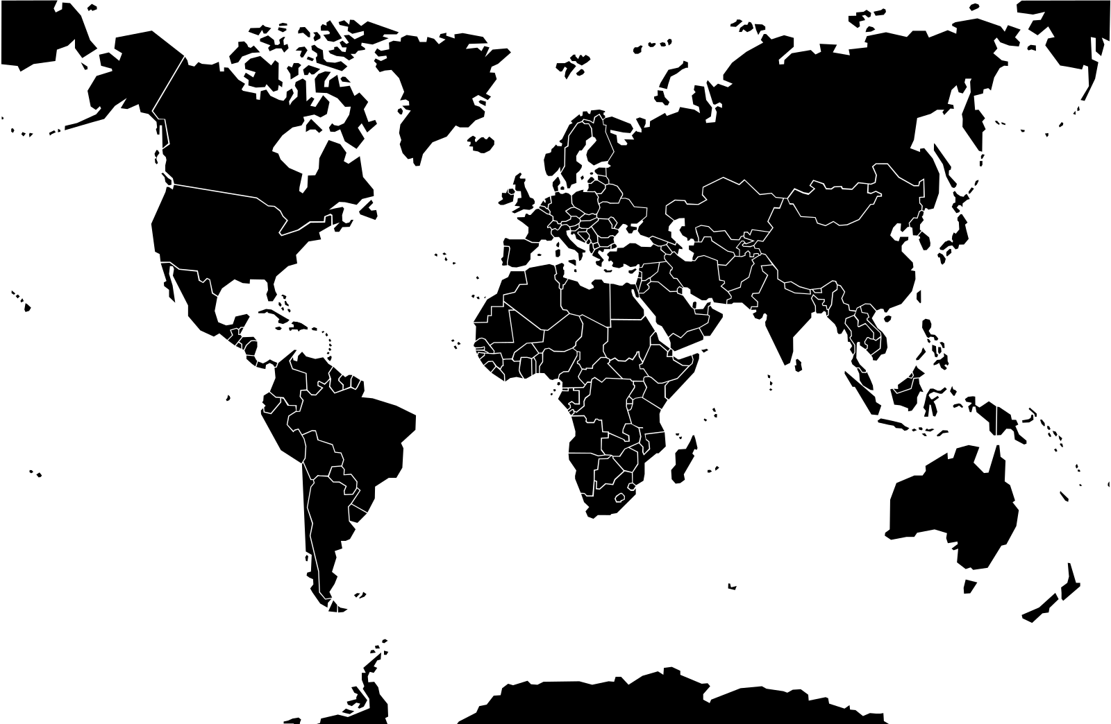
Small World of Words project
Russian
Korean
French
English
German
English
Dutch
Mandarin
French
Italian
Japanese
Portuguese
Spanish
Cantonese
Vietnamese
Spanish
Rioplatense
Portuguese
English
+ 500,000 participants
https://smallworldofwords.org/project

Slide 10
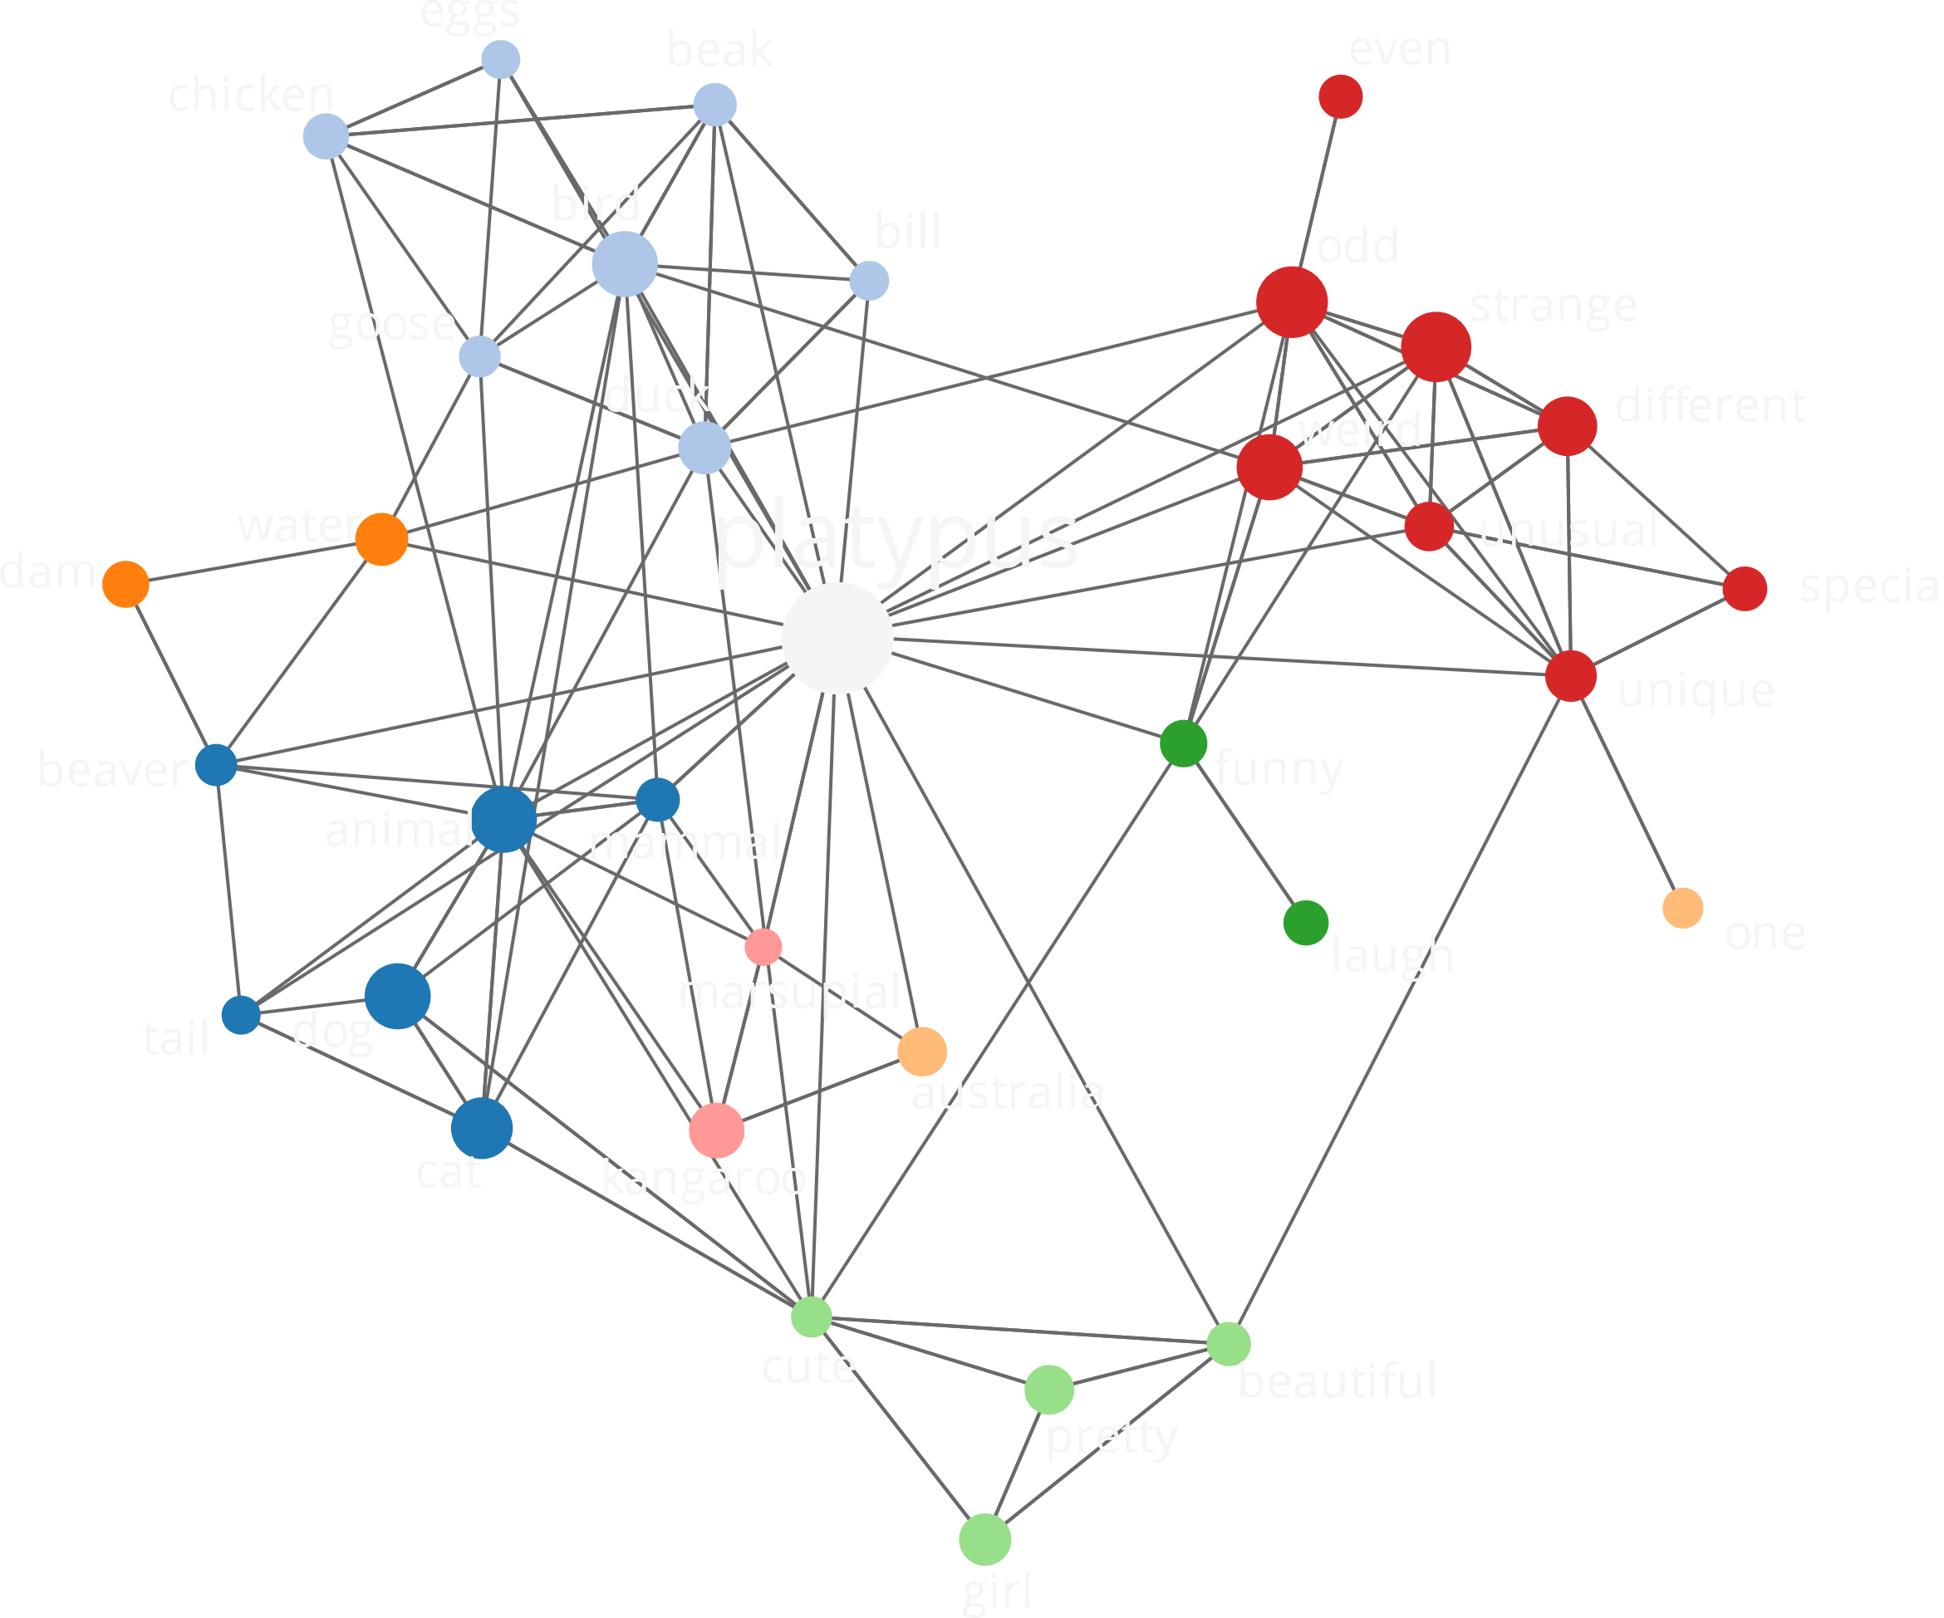
Empirical lexico-semantic network
MAIN CHARACTERISTICS
Free association
Edges, nodes and weights observed
Meaning = spreading activation over weighted edges
Sizeable implementation covering most words
WORD ASSOCIATION TASK
12,000 English cue words, +80,000 pps
Continued Responses: R1, R2, R3
3M association responses

Slide 11
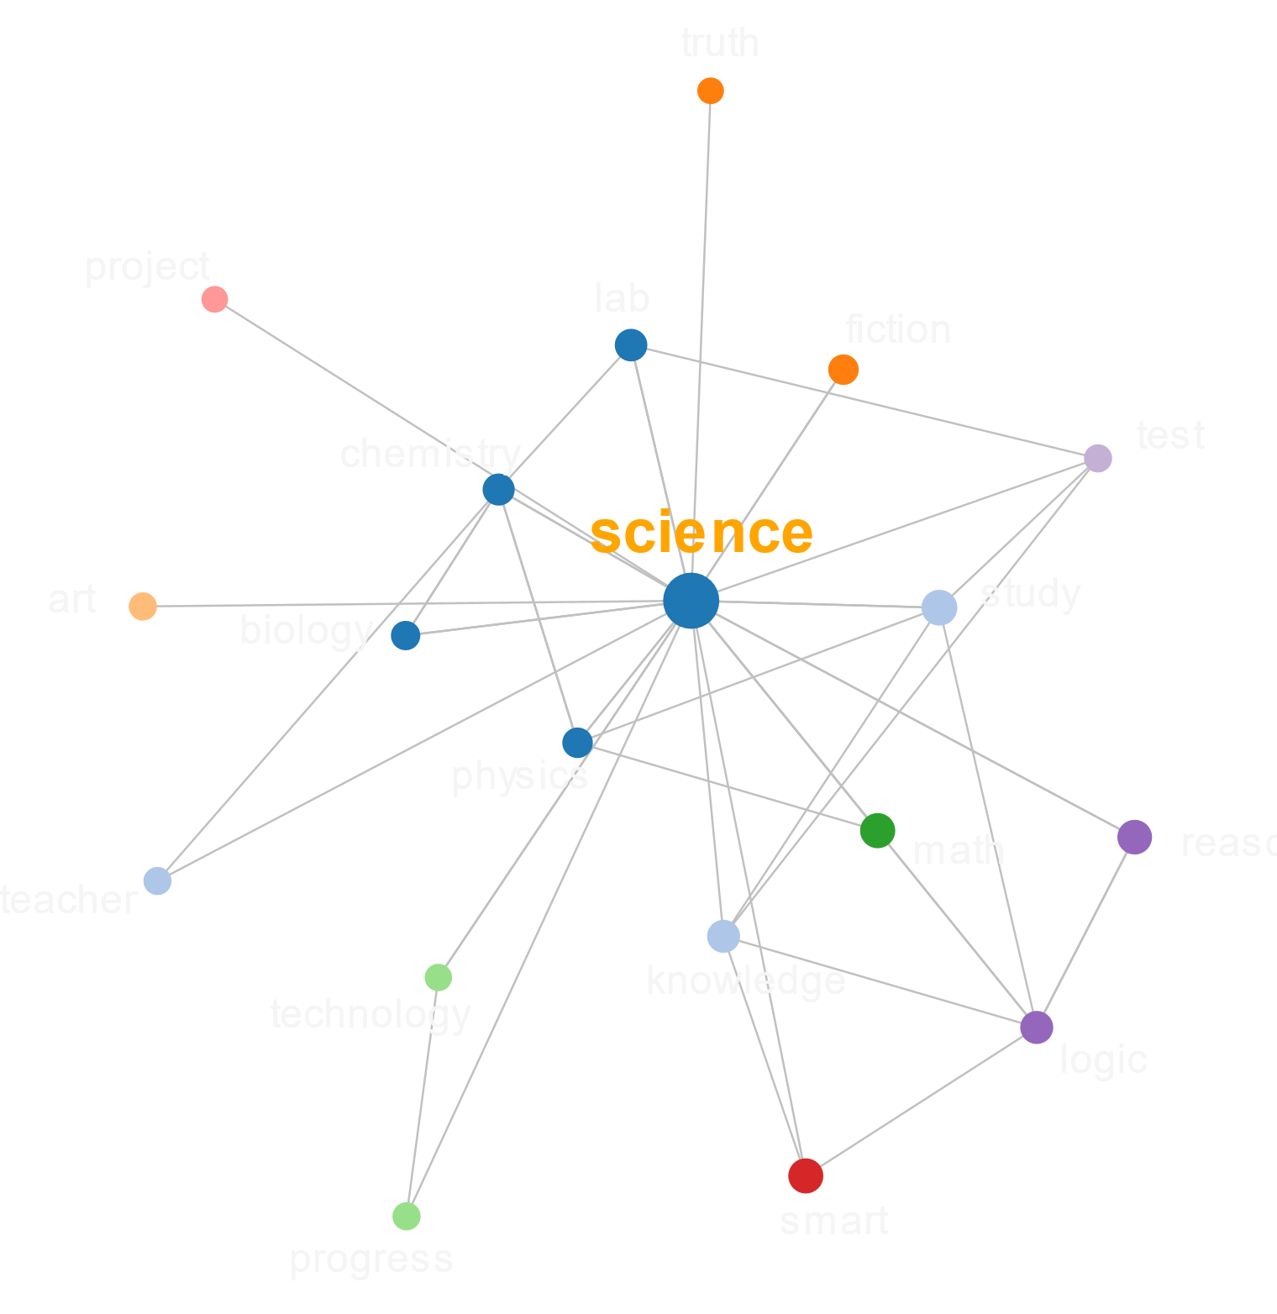
Why continued associations?
Single Responses
General drawback of word associations (Aitchison, 2003)
Lack of weak responses problematic for various tasks including mediated priming (Chwilla et al., 2000)
Notes:
Single response = standard in previous large datasets (USF, EAT)

Slide 12
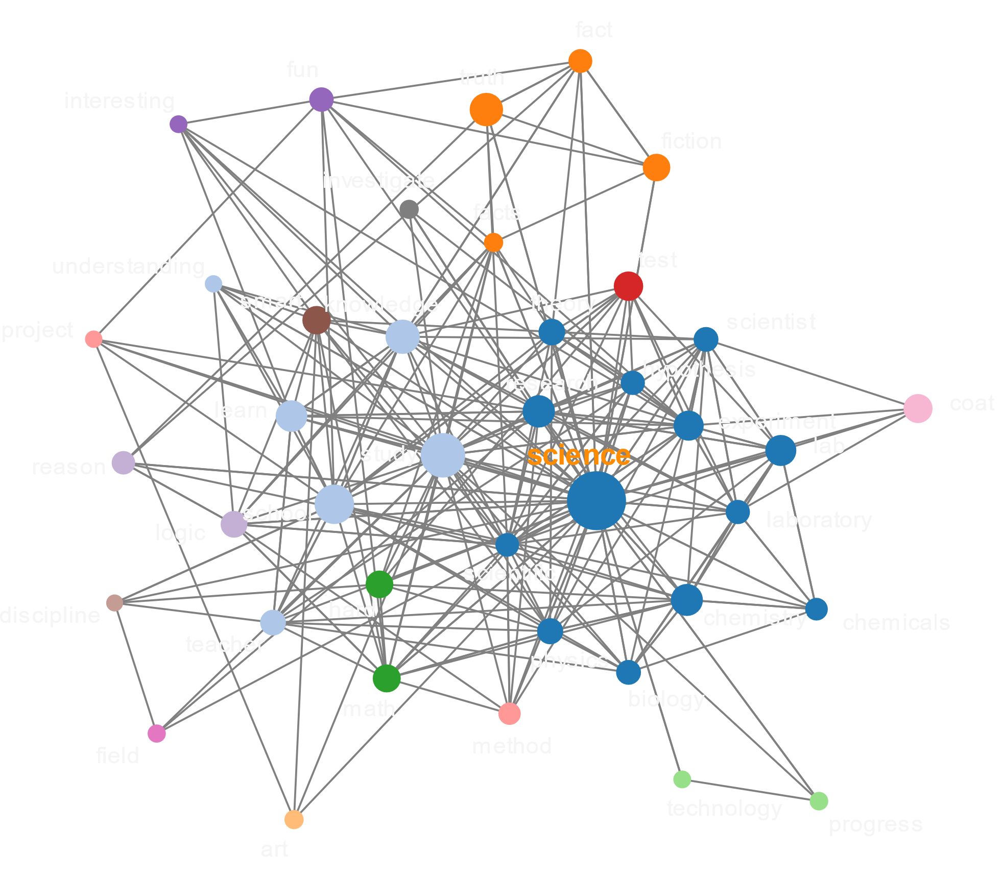
Why continued associations?
Single Responses
General drawback of word associations (Aitchison, 2003)
Lack of weak responses problematic for various tasks including mediated priming (Chwilla et al., 2000)
Dominance Effects
umbrella: 90% of people provide rain
Possible other associates?
Notes:
Single response = standard in previous large datasets (USF, EAT)

Slide 13
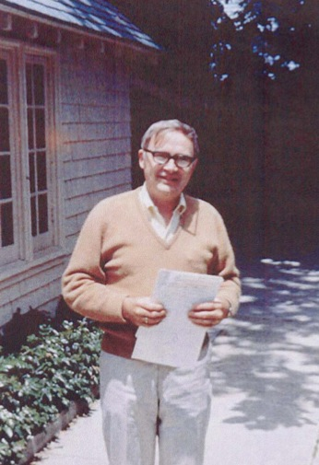
The structure of associations in language and thought
James Deese (1965):
“The interest of psychologists in associations has always been misguided… the whole classical analysis of associations centered around the circumscribed and uninteresting problem of stimulus – response, of what follows what.”

Slide 14
Microscopic Level

Slide 15
Word association hubs
Microscopic Structure
Dataset | 1 | 2 | 3 | 4 | 5 | 6 | 7 | 8 | 9 | 10
SWOW-NL | money | water | food | car | music | pain | tasty | school | child | pretty
SWOW-EN | money | food | water | car | love | music | work | happy | old | bird
EAT | money | water | food | man | car | me | sex | sea | good | home
USF | money | car | water | food | bird | dog | tree | child | good | book
Natural language hubs
Dataset | 1 | 2 | 3 | 4 | 5 | 6 | 7 | 8 | 9 | 10
SUBTLEX-NL | go | do | know | come | good | say | see | think | love | sit
SUBTLEX-US | make | do | time | little | people | know | think | way | see | new
BNC | say | see | know | time | year | think | come | last | give | people
KF | say | can | time | new | do | man | make | year | people | little
CELEX-NL | say | see | stand | know | find | time | sit | take | two | woman
CELEX-EN | go | come | say | see | make | stand | good | do | think | big

Slide 16
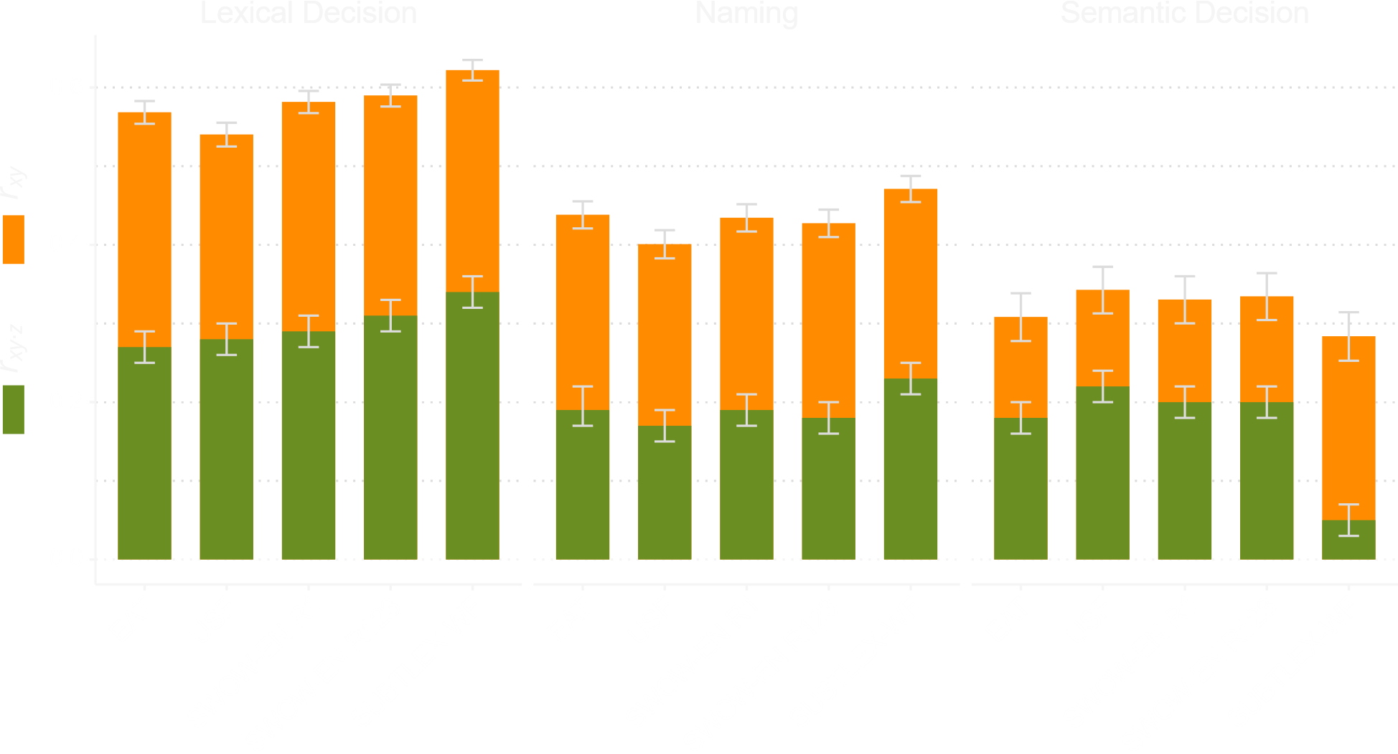
Centrality in psycholinguistic tasks
Correlation between node in-strength and RT
De Deyne et al. (2019)

Slide 17
Mesoscopic Level

Slide 18
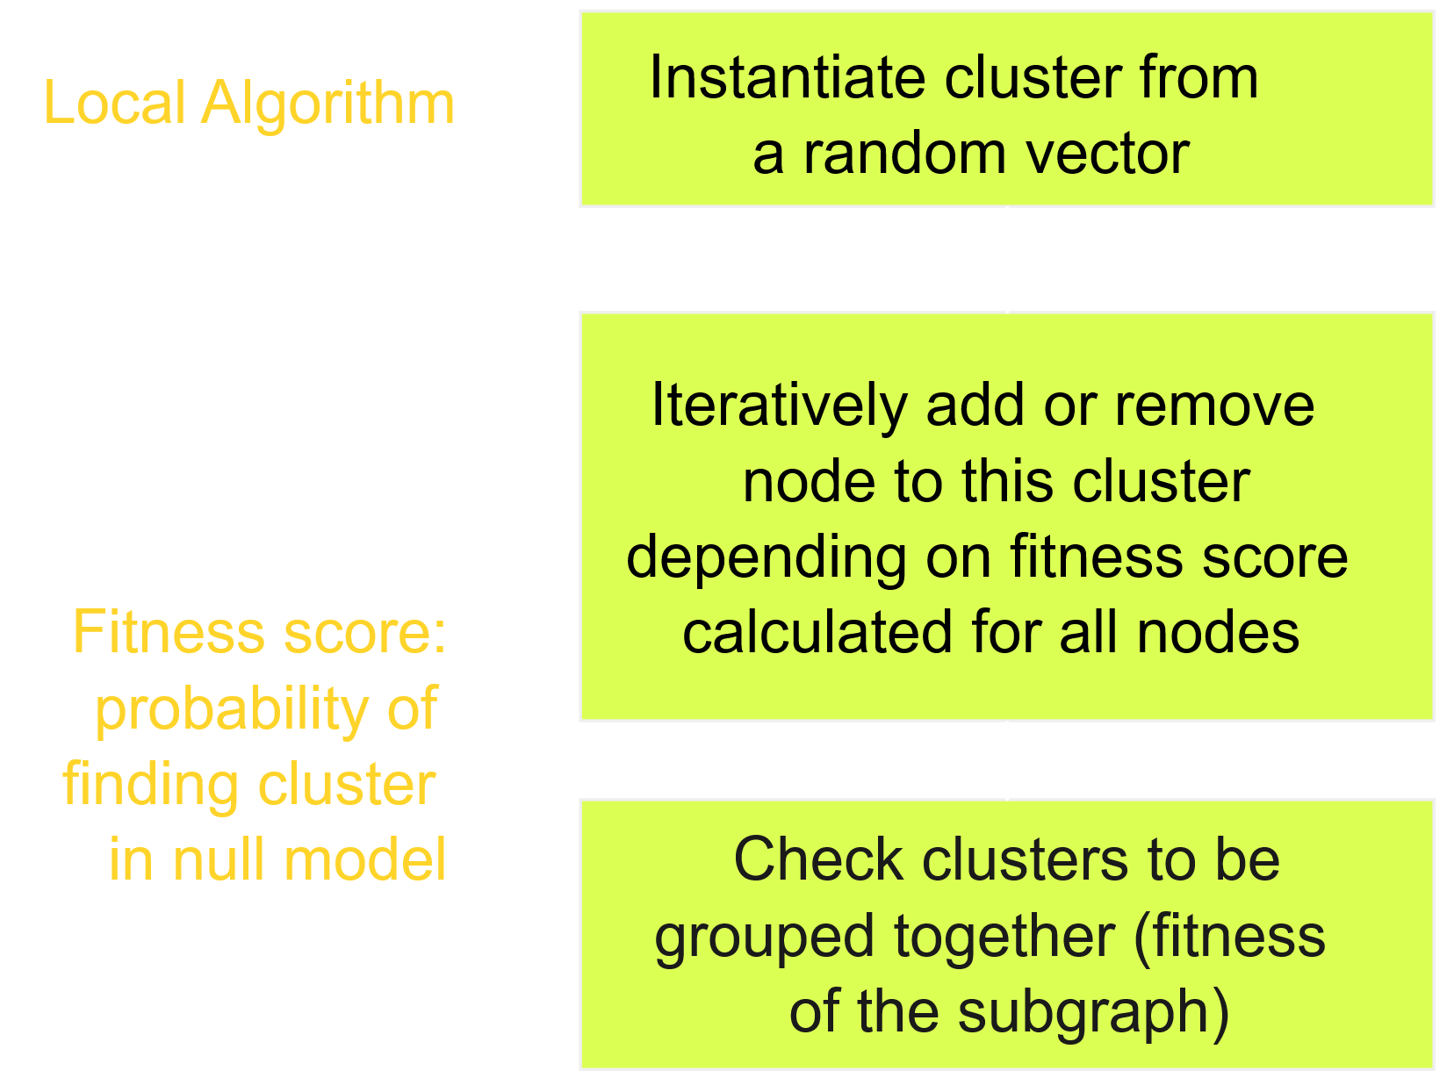
Explore semantic structure
Method
Network Community Detection
Modularity optimisation
Huge directed weighted graphs
Statistical approach: significance of hierarchical overlapping communities
Results
Measure | 1 | 2 | 3 | 4 | 5
# Communities | 2 | 7 | 37 | 161 | 506
Average size | 8588 | 3049 | 515 | 112 | 25
# Homeless nodes | 18 | 18 | 39 | 86 | 380
# Overlapping nodes | 5943 | 6956 | 5263 | 4717 | 1676
Max(overlapping nodes) | 2 | 7 | 8 | 10 | 6
Mean(p) | 0 | 0.062 | 0.04 | 0.035 | .051
infreq. words: codex, agalev,…
homonyms: bank
polysemes: language (nationality, speech, education, communication)
De Deyne, Verheyen, Perfors & Navarro (2015)

Slide 19

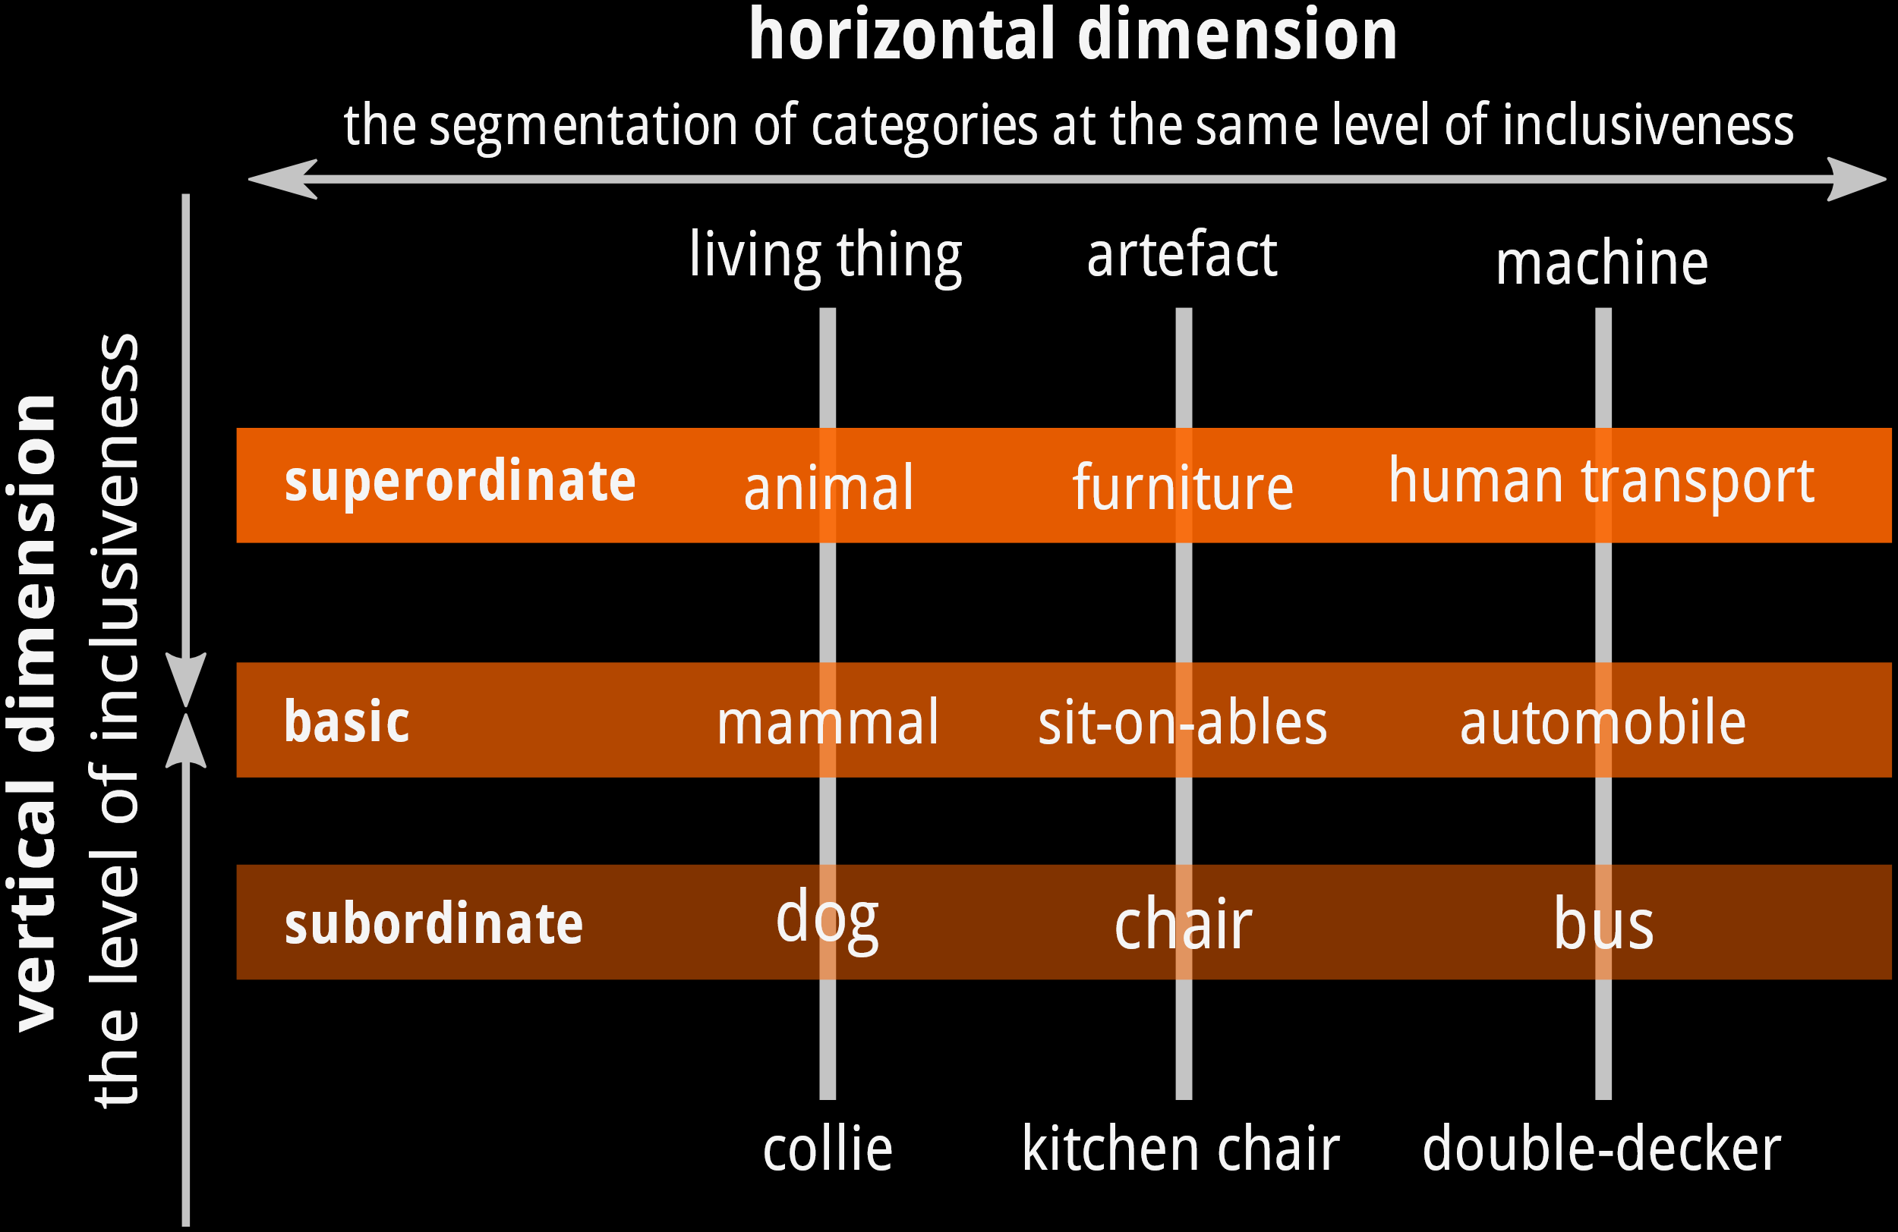
Mesoscopic Structure
Evidence for hierarchical thematic structure across different POS
Clusters: partly overlapping with central category labels
Taxonomic structure present when category exemplars (concrete nouns) are isolated
Notes:
So what’s interesting here, is that the semantic network perspective highlights how local properties affect global structure.
In Gert’s talk we’ll see other examples of this, showing that certain variables like concreteness and valence can be easily derived from these networks.
Also, see the Schelling Model (cf ref in Kleinberg):
how global patterns of spatial segregation can arise from the effect of homophily operating at a local level. There are many factors that contribute to segregation in real life, but Schelling’s model focuses on an intentionally simplied mechanism to illustrate how the forces leading to
segregation are remarkably robust | they can operate even when no one individual explicitly wants a segregated outcome.””
A spatial model of segregation

Slide 20
Widespread Thematic structure
p < 0.01 | p = 0.03 | p = 0.07 | p = 0.08 | p = 0.14 | p = 0.14
French fries | arrogant | get | beach | mystery | coffee
greasy | haughty | understanding | sea | solve | tea
fryer | haughtily | insight | sun | puzzle | bag
mayonnaise | conceited | understand | holidays | question | cup
fat | snob | awareness | summer | reflect | chocolate milk
unhealthy | unsympathetic | understanding | sand | answer | warm
ketchup | pride | realize | sunbathing | solution | milk
hamburger | vain | see | coast | ask | cocoa
roll | pretension | realize | parasol | problem* | mug
sauce | patronizing | notion | wind | think | tea time
fastfood | look down | know | warm | problem | teapot
fryhouse | superior | conscious | sandcastle | difficult | tea-bag
snack | arrogance | clue | tan | question mark | tableware
croquette | inferior | sink in | bikini | sudoku | cocoa
fries | egocentric | know | sunbathe | quiz | filter
stall | pedantic | click | shell | quiz* | thermos
snack | contempt |  | terrace | challenge | cappucino
ground beef | spoiled |  | surf | crossword | coffee
mustard | elitist |  | dune | guess | visit
sausage | pleased with |  | Australia | assignment
kebab | mundane |  | sea breeze | questionnaire
... | ... |  | ... | ...
Notes:
So you can see a mixture of paradigmatic and syntagmatic responses. And as a dictionary, this defines both the meaning in terms of synonyms and properties

Slide 21
Macroscopic Level

Slide 22
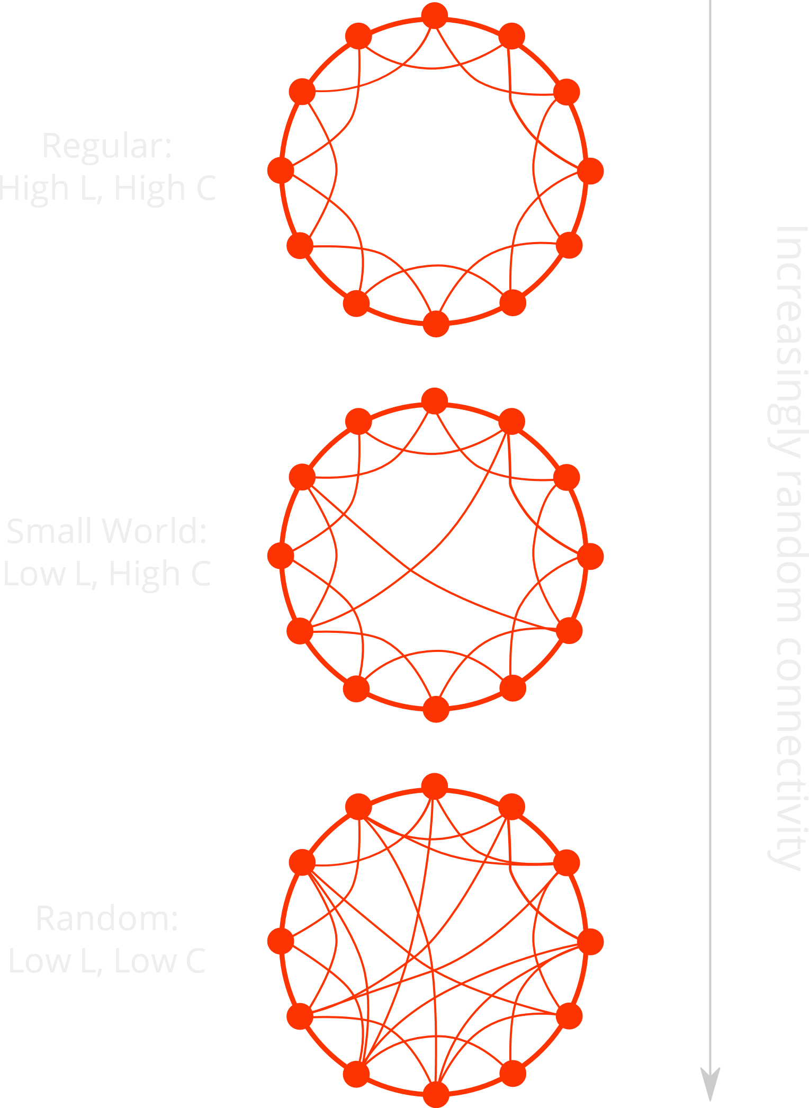
Macroscopic Structure
Density and Average Path Length
G₁ : d = .22, L = 4.14 steps
G₁₂: d = .43, L = 3.38 steps
G₁₂₃: d = .64, L = 3.06 steps
Small-World properties of G₁₂₃
Strong interconnected regions
(CC = .331 vs CC_{rand} =.045)
Notes:
Needs to be motivated stronger

Slide 23
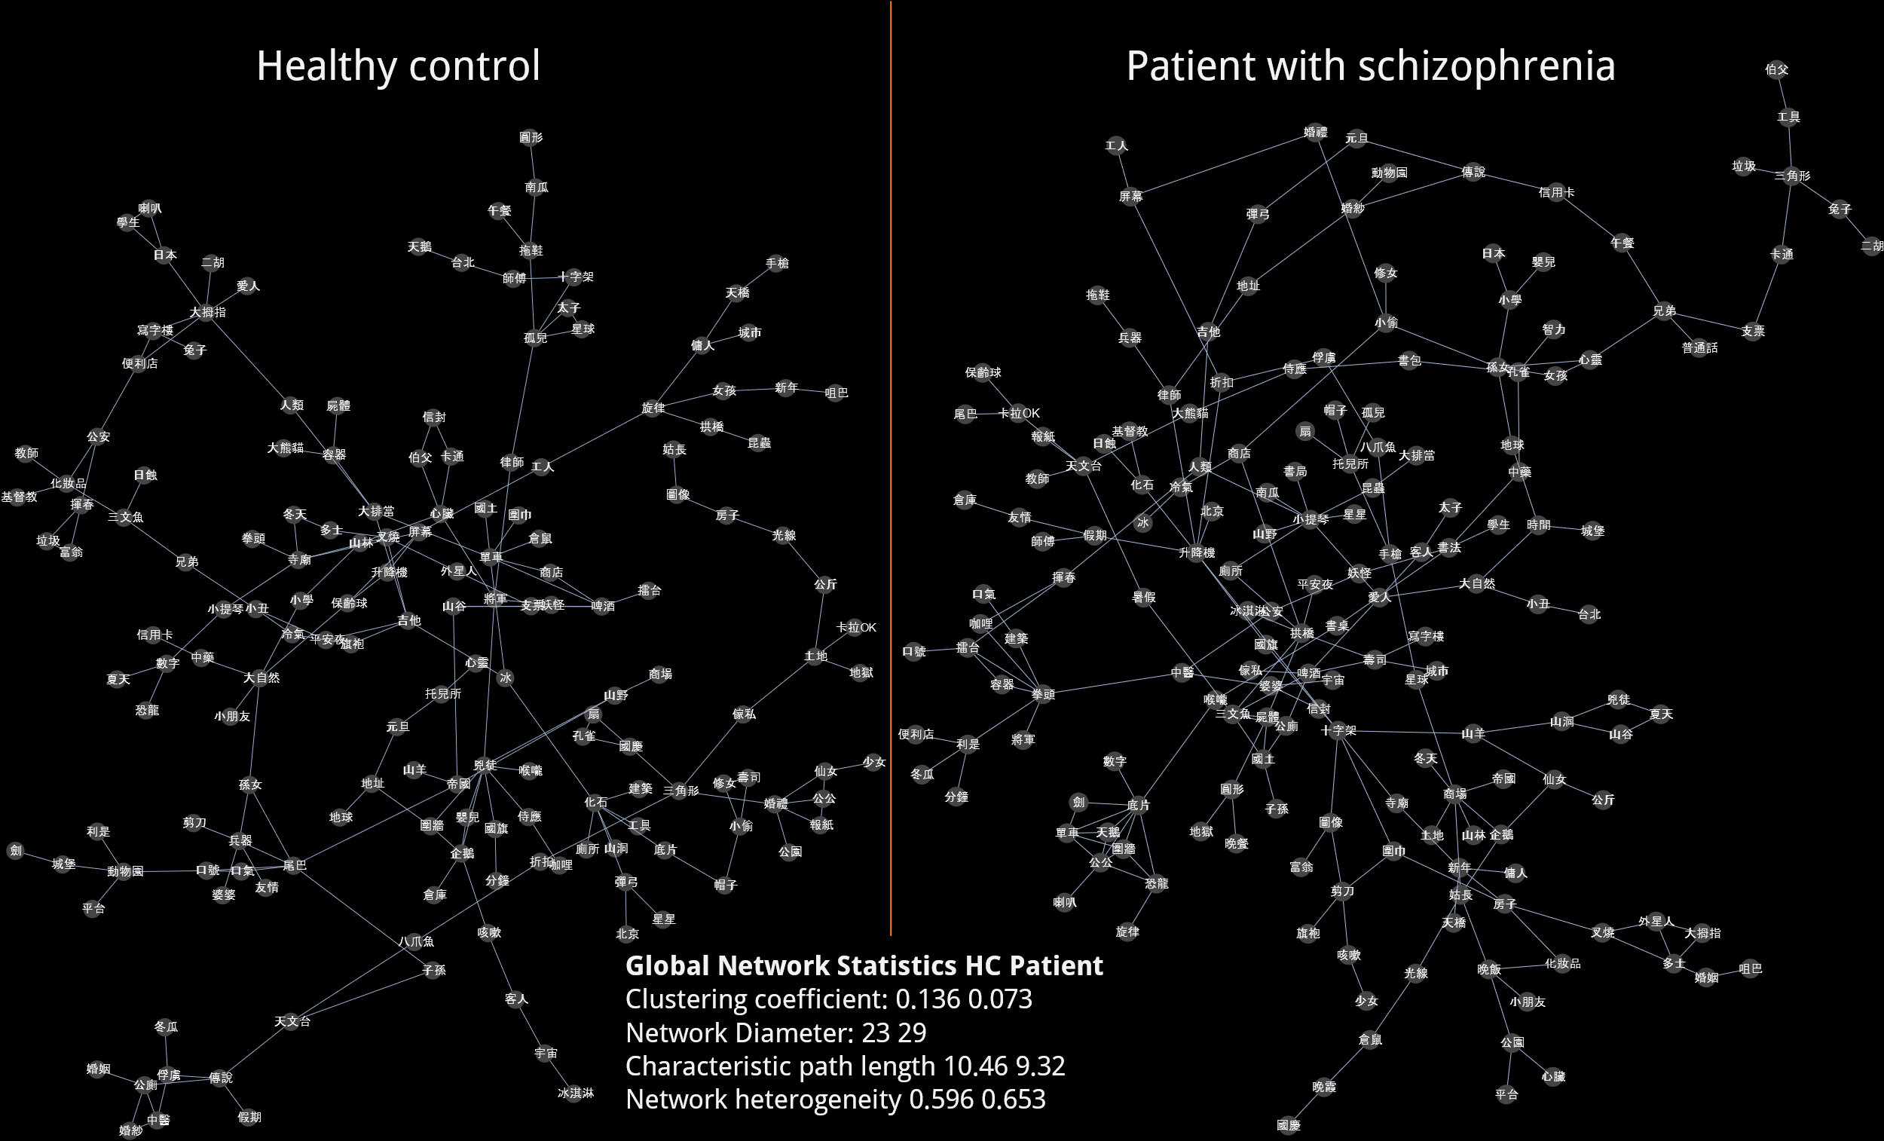
Applications to language disorders
De Deyne, Elvevåg, Hui, Poon, & Chen (2017)
Notes:
Hope to collect data at the individual level or at least small groups, so we have a project now called “MySWOW”

Slide 24
Connecting Micro, Meso & Macro
1. The case of assortative mixing

Slide 25
Node Assortativity
Assortative mixing
“Likes like like”
Age, race in social networks
Measure ≈ correlation coef.
Different from bias
What word properties determine the presence of an associative link?
Discrete lexical covariates
POS: Noun, Verb, Adj
Assortative: paradigmatic
Disassortative: syntagmatic
Scalar lexical covariates
Psycho-affective: Valence, Arousal, Dominance
Semantic: Concreteness, Age-of-Acquisition
Distributional: Word Frequency, Contextual Diversity
Notes:
So for example the fundamental positivity effect or Polyana

Slide 26
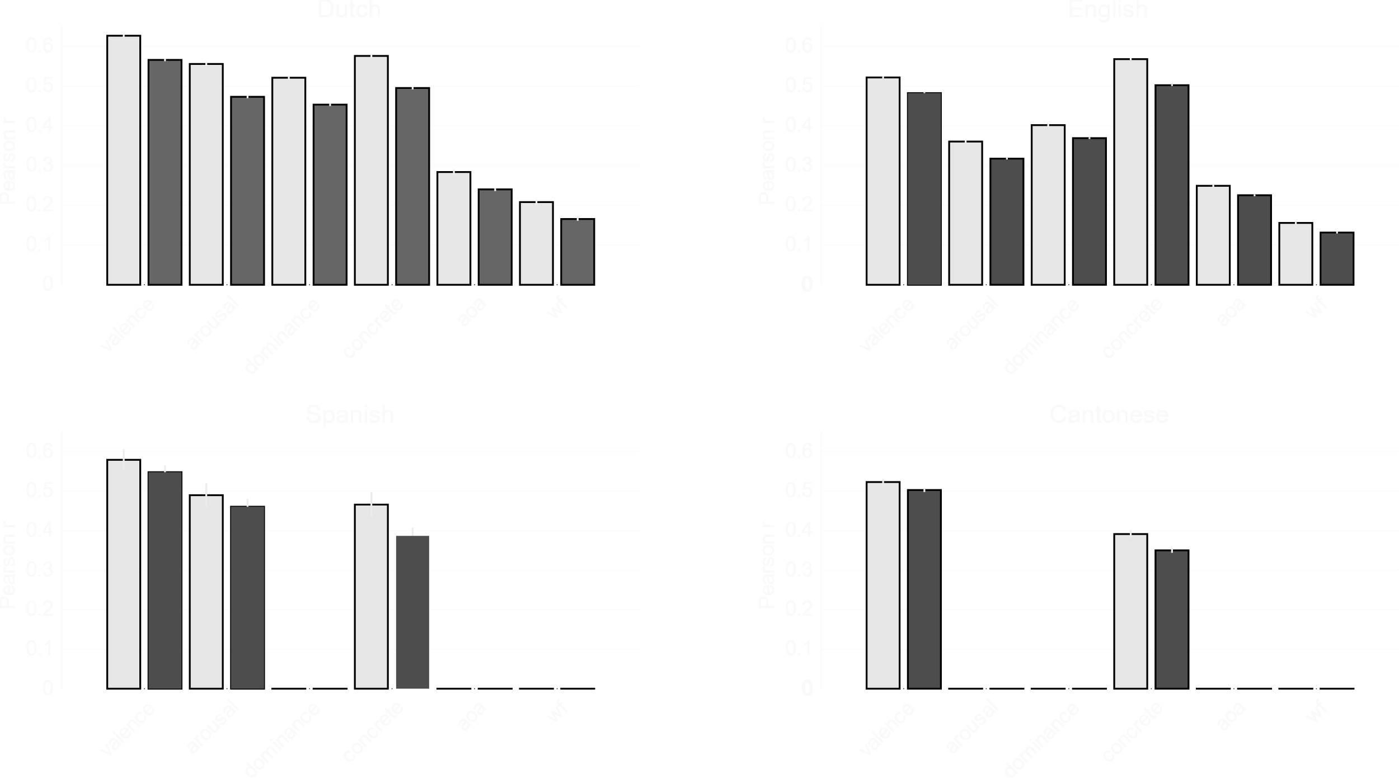
Local Assortativity
To what degree do cues and responses exhibit assortativity?

Slide 27
Macroscopic Assortative structure
Notes:
So what’s interesting here, is that the semantic network perspective highlights how local properties affect global structure.
Also, see the Schelling Model (cf ref in Kleinberg):
how global patterns of spatial segregation can arise from the effect of homophily operating at a local level. There are many factors that contribute to segregation in real life, but Schelling’s model focuses on an intentionally simplied mechanism to illustrate how the forces leading to
segregation are remarkably robust | they can operate even when no one individual explicitly wants a segregated outcome.””
A spatial model of segregation

Slide 28
Implications
Local assortativity determines a graph’s global structure
Global emergent pattern suggests two main organising factors:
Valence
Concreteness (cf PCA-weights)
Extends Osgoods’ findings for nouns to entire lexicon
Issue of scale: including all words (not just emotive ones) shows novel contribution of concreteness
Van Rensbergen, Storms & De Deyne, 2016 De Deyne, Navarro & Perfors, in preparation

Slide 29

Connecting Micro, Meso & Macro
2. Local and Global Similarity

Slide 30
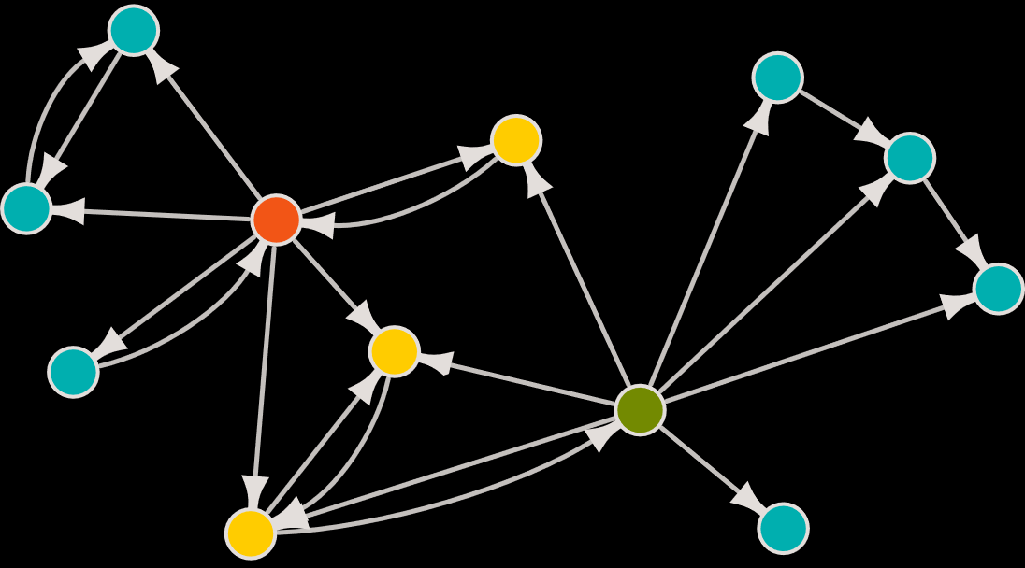




Spreading activation model
Local Similarity Measure
Neighbour distributional overlap
Cosine: Degree of sharing immediate neighbours
Graph-based global similarity
Random walk based measure similar to Katz Index
Similar nodes share neighbours that are also similar
Procedure
G converted to a row-normalized transition matrix
$$G_{rw(1)}=I$$
$$G_{rw(2)}=I+αG$$
$$G_{rw(3)}=I+αG+α^{2}G$$
Weights
$$in the limit G_{∞}= \sum_{r=0 }^{∞}{{\left(αG\right)}^{r}}$$
$$max⁡\left(0,\log_{2}{\frac{P\left(resp | cue\right)n}{P(resp)}}\right)$$
α determines contribution of short over longer paths
➔ limits spread of activation

Slide 31
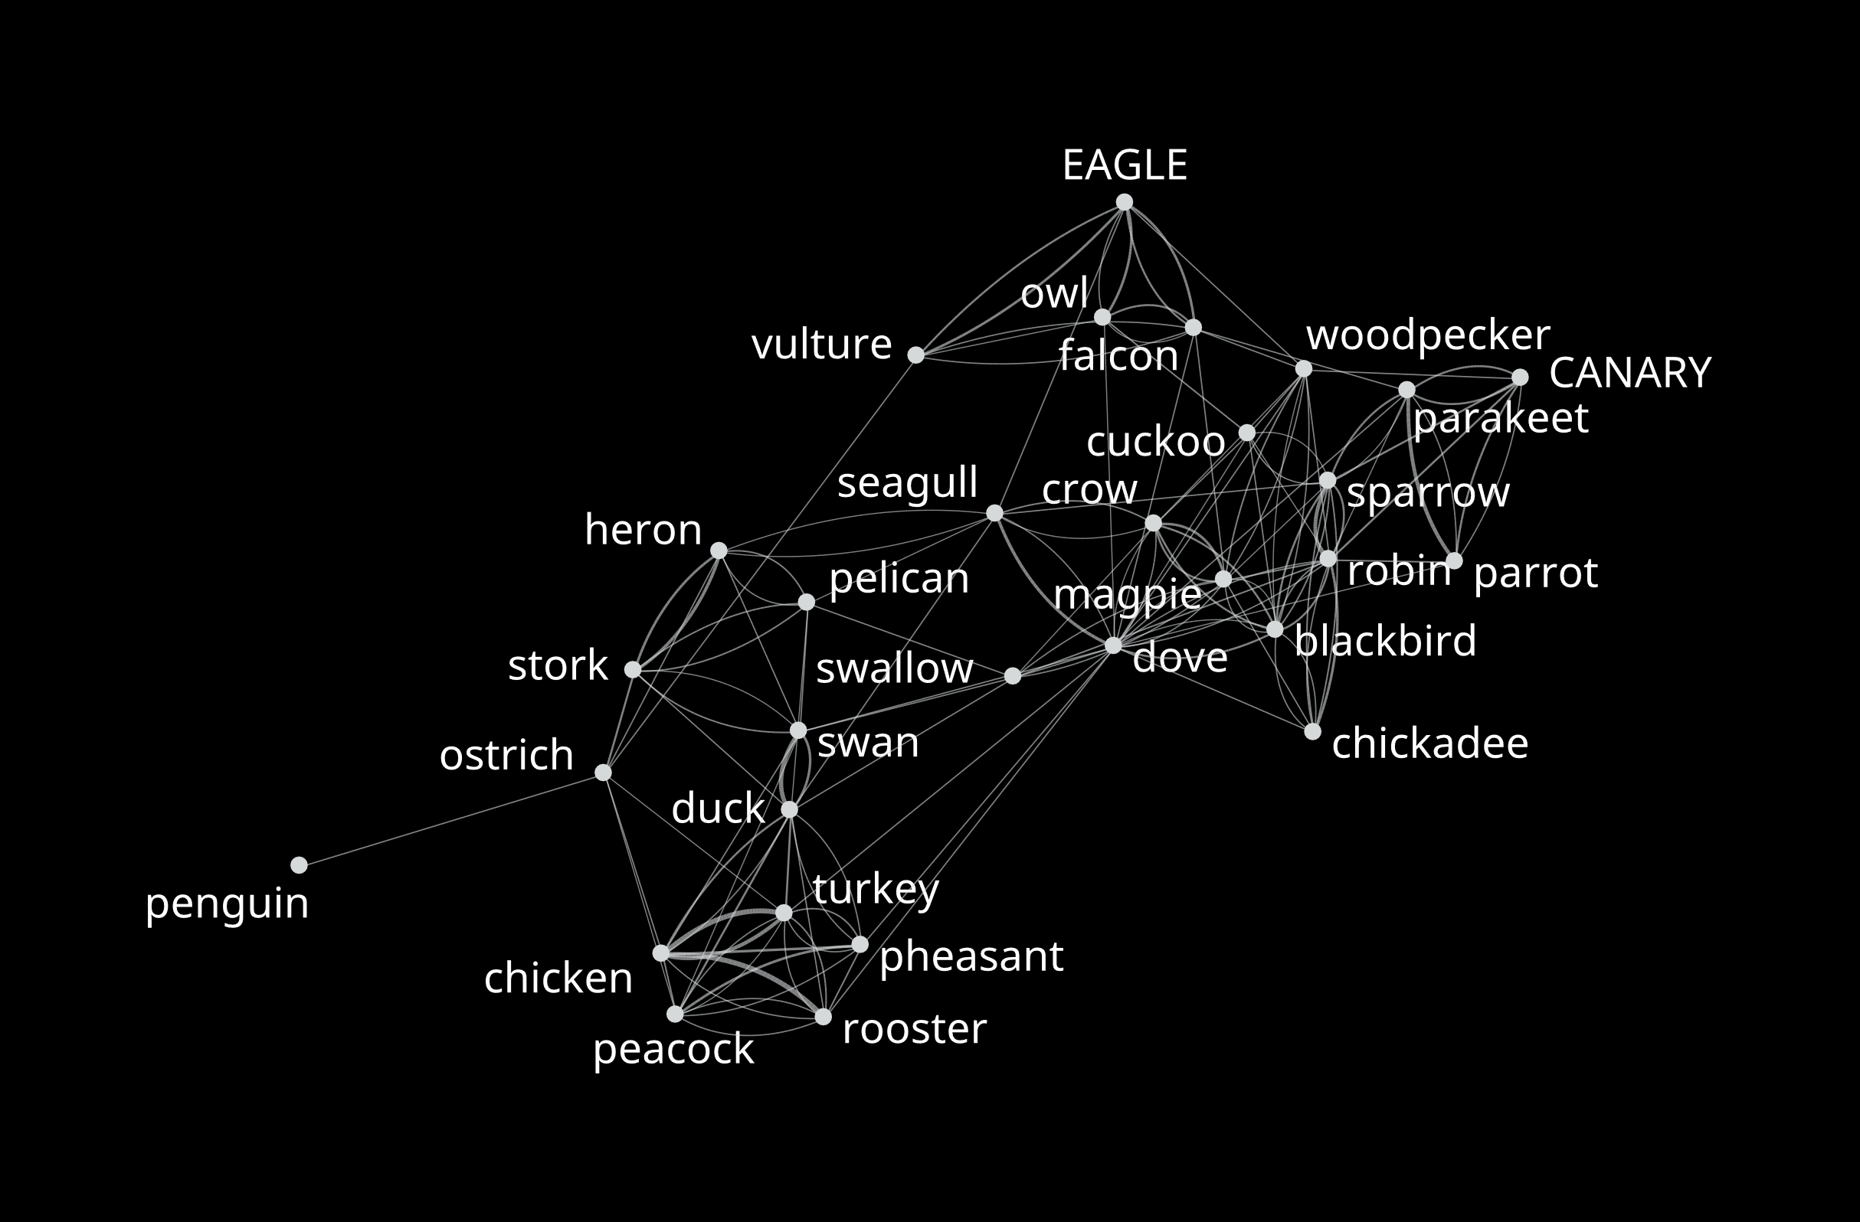
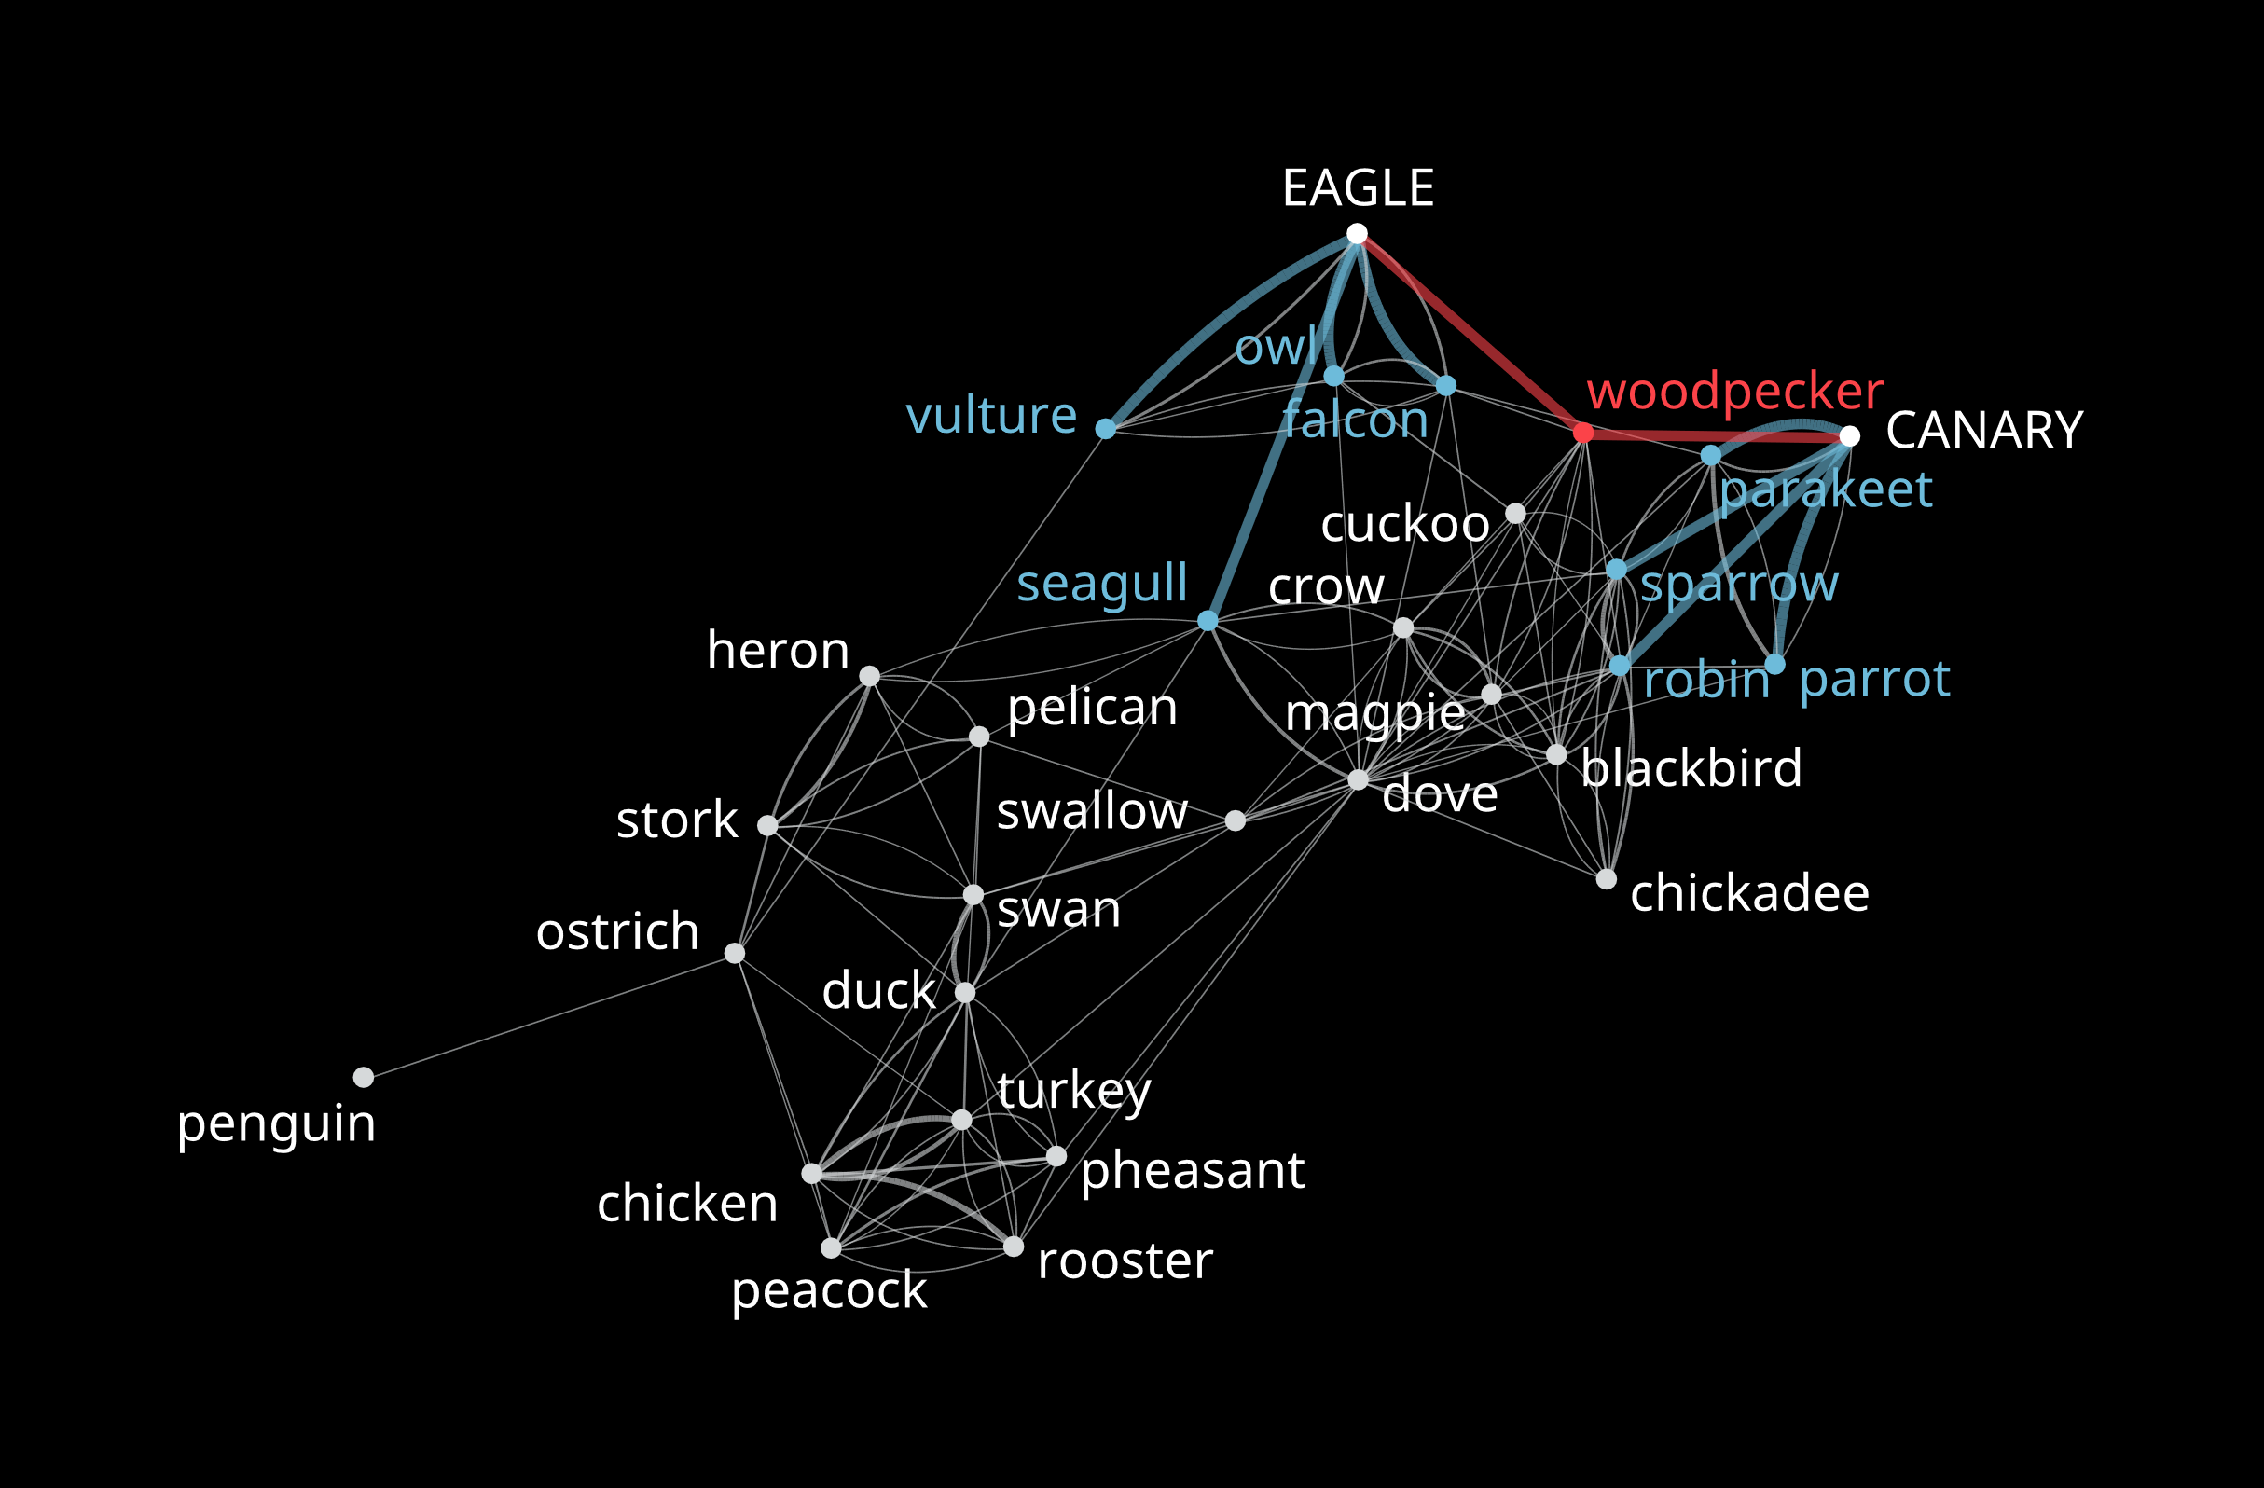
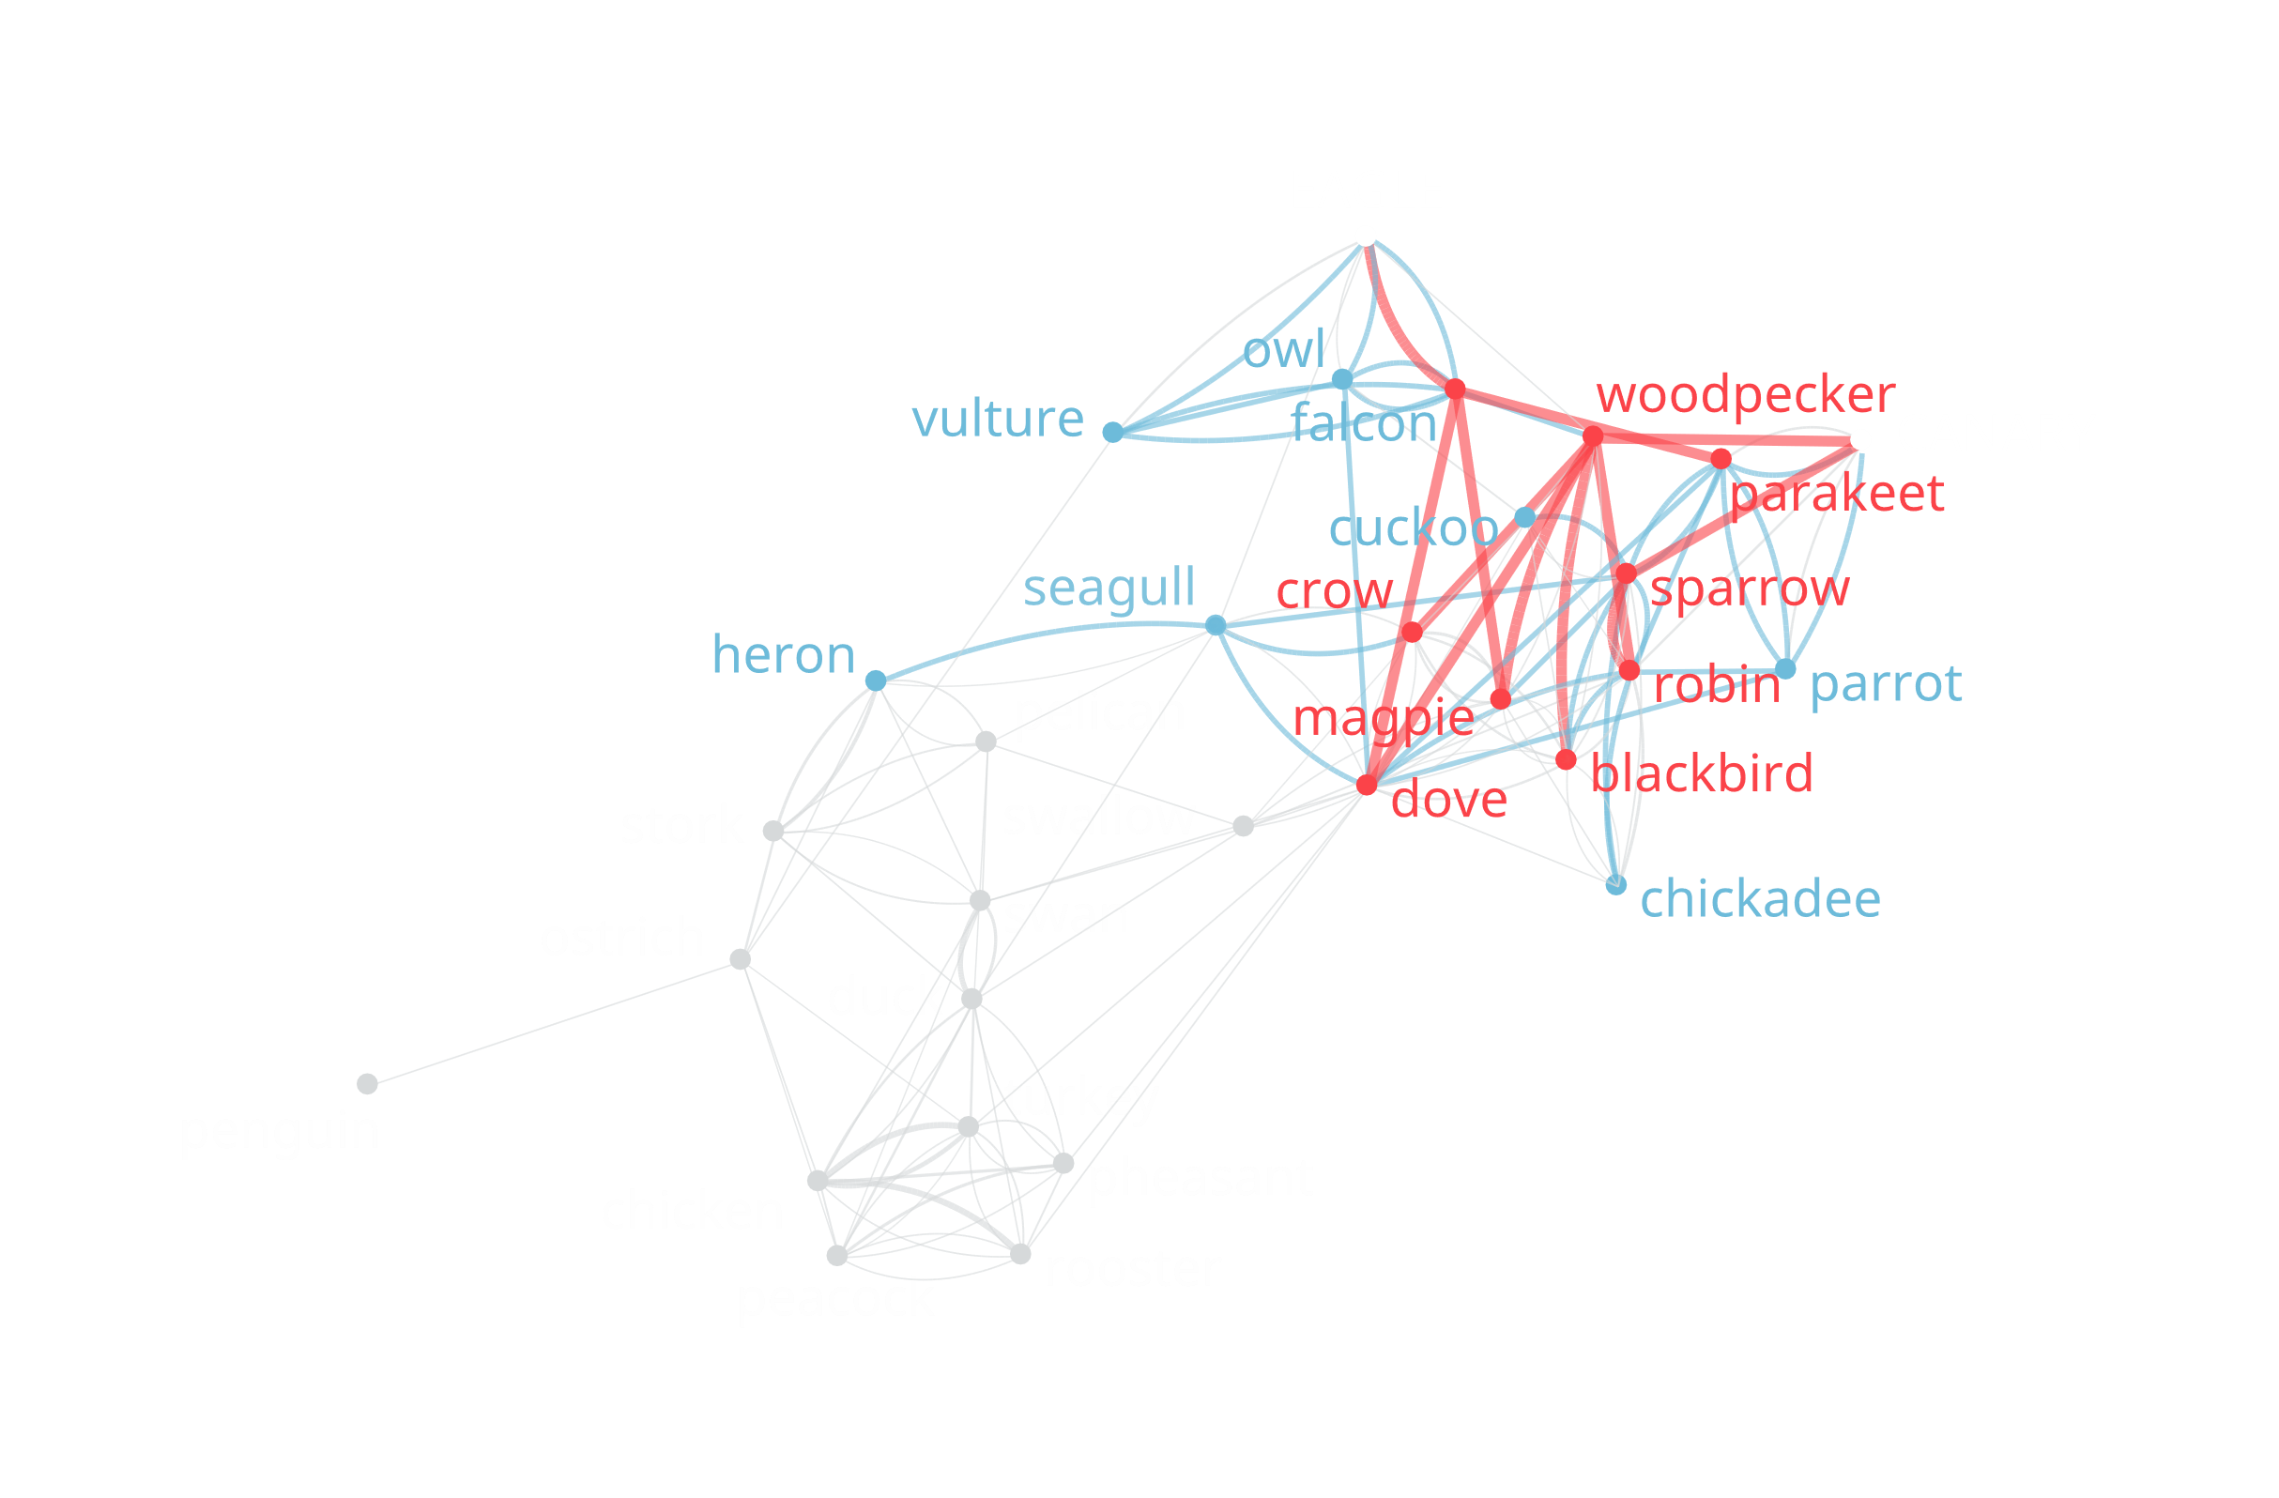
Paradigmatic NN example
How similar is EAGLE to CANARY?
Local similarity: only one shared neighbor
Indirect paths of length 2: 8 shared neighbors
De Deyne, S., Navarro, D., & Perfors, A. (2018)
Notes:
Paths of length two, multiple neighbors

Slide 32
Spreading activation example II
Example of new paths for tiger
α = 0.25 | α = 0.50 | α = 0.75 | α = 0.95
leopard | leopard | leopard | lioness
safari | safari | hyena | hyena
bear | hyena | lioness | cougar
zebra | lioness | safari | leopard
giraffe | zebra | zebra | devour
fox | giraffe | devour | jungle
 | devour | pheasant | Jerry can
 | pheasant | carnivore | carbine
 | carnivore | cougar | pheasant
 | jaguar | bird of prey | bird of prey
D = 0.01 | D = 0.03 | D = 0.08 | D = 0.10

Slide 33
Relatedness across the lexicon
Common categories
fruit, insects, tools, …
Domains
artifacts, animals
Arbitrary concepts nouns
Behavioural
High similarity / inter-subject agr.
Low similarity / inter-subject agr.
Psychologically small, finite number of features shared among individuals (Medin & Ortony, 1989)
Infinite number of ways two concepts can be similar (Goodman, ‘72, Medin, Goldstone & Gentner, ‘93)
Explanations
Lexico-semantic view
Humans continuously track weak linguistic contingencies lead to stable structure shared among individuals across a range of concept relations
Empirically no clear evidence, and issue of sparsity of the input

Slide 34
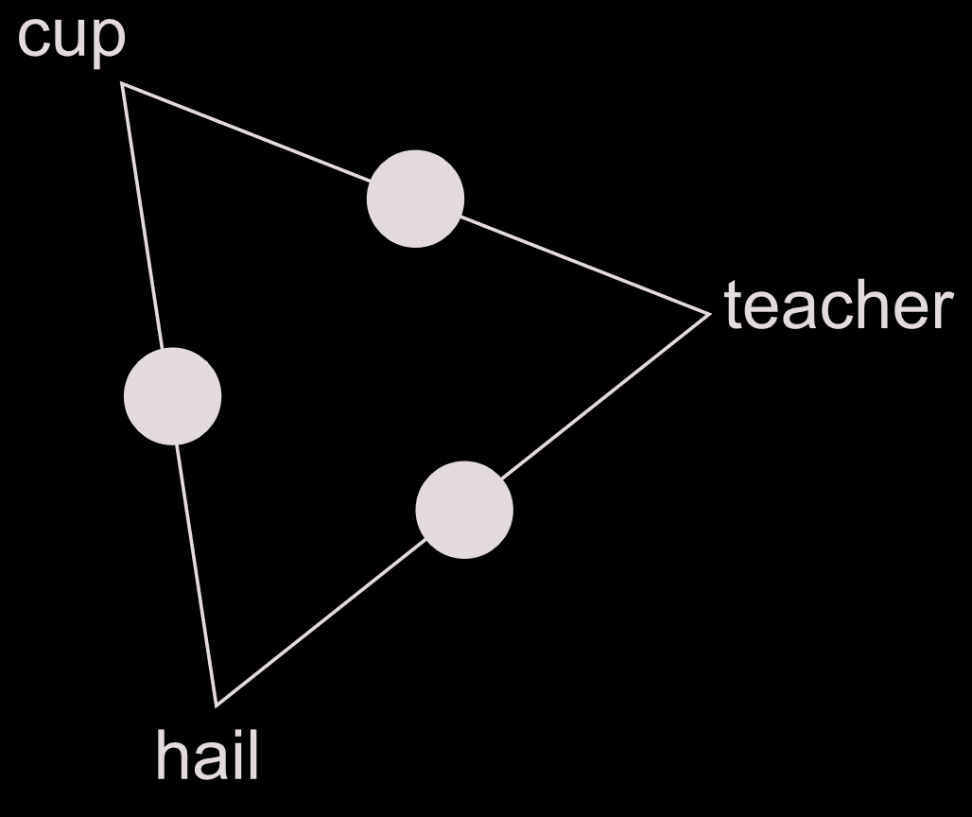
Structure in remote concepts
Stimuli
100 randomly generated triads
Examples:
Sunday - vitamin - idiot
dark - heat - shot
Same frequency band, same concreteness range
Mostly weakly related pairs
Method
"Choose strongest related pair"

Slide 35
Structure in domains and categories
DOMAIN TRIADS
Stimuli
Animals, Artifacts, Food, Activities
Words occur only once
pigeon - sardine - butterfly
jeep - gun - sweater
deer - peacock - salmon
BASIC LEVEL TRIADS
Stimuli
taken from De Deyne et al. (08)
4 x Animals, 6 x Artifacts 2 x Food, 2 x Activities
goldfish - shark - pike
donkey - horse - zebra
onion - cauliflower - parsley

Slide 36
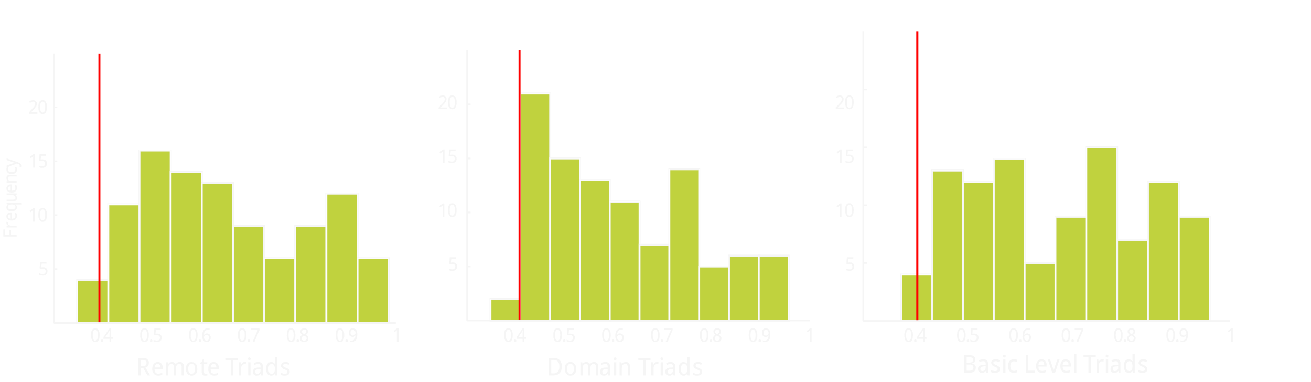
Do participants agree about remote, domain and basic triads?
Dominant choice probability and 95% confidence boundary for random choice (N=100)
→ Agreement among participants preferences for majority of triads

Slide 37
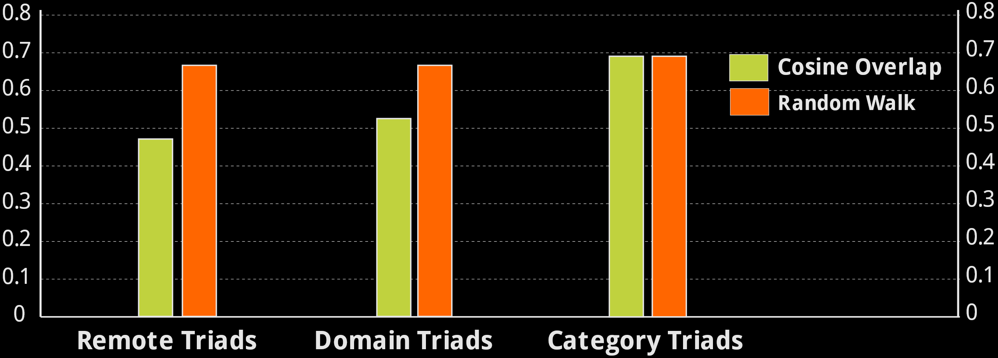
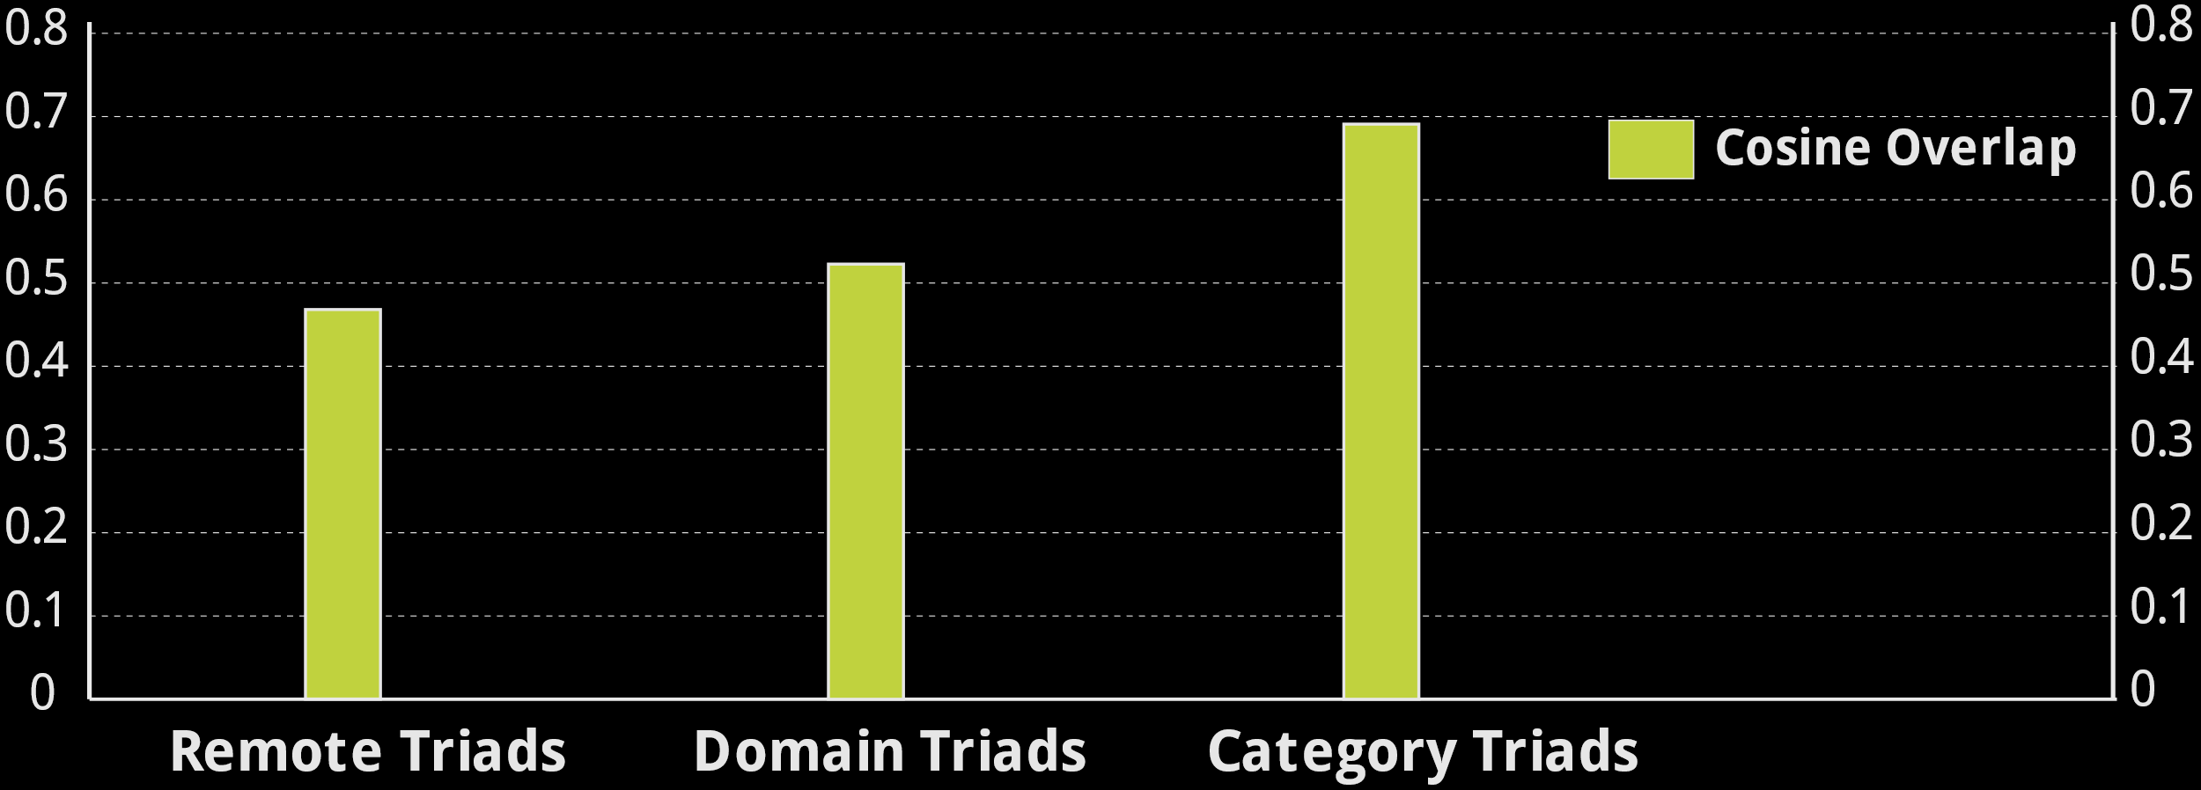
Overview model findings

Slide 38
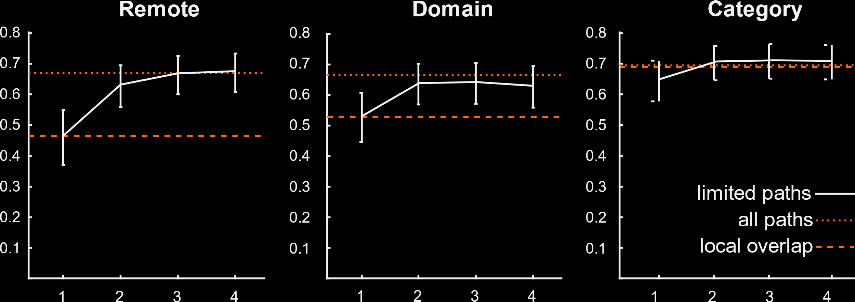
The role of path length

Slide 39

Interim conclusions
Methodological
Random walk: interesting way to model spreading activation, using little heuristics
Improvements across a range of relations (remote, domains, basic)
Limited walks address concerns by extent of spreading activation throughout network
Strong test for inference in lexico-semantic models
Theoretical
Similarity: Sufficiently constrained between remote pairs
A connected homogeneous view of lexicon bridging associative and semantic meaning
Notes:
Add results from E-language models here!

Slide 40
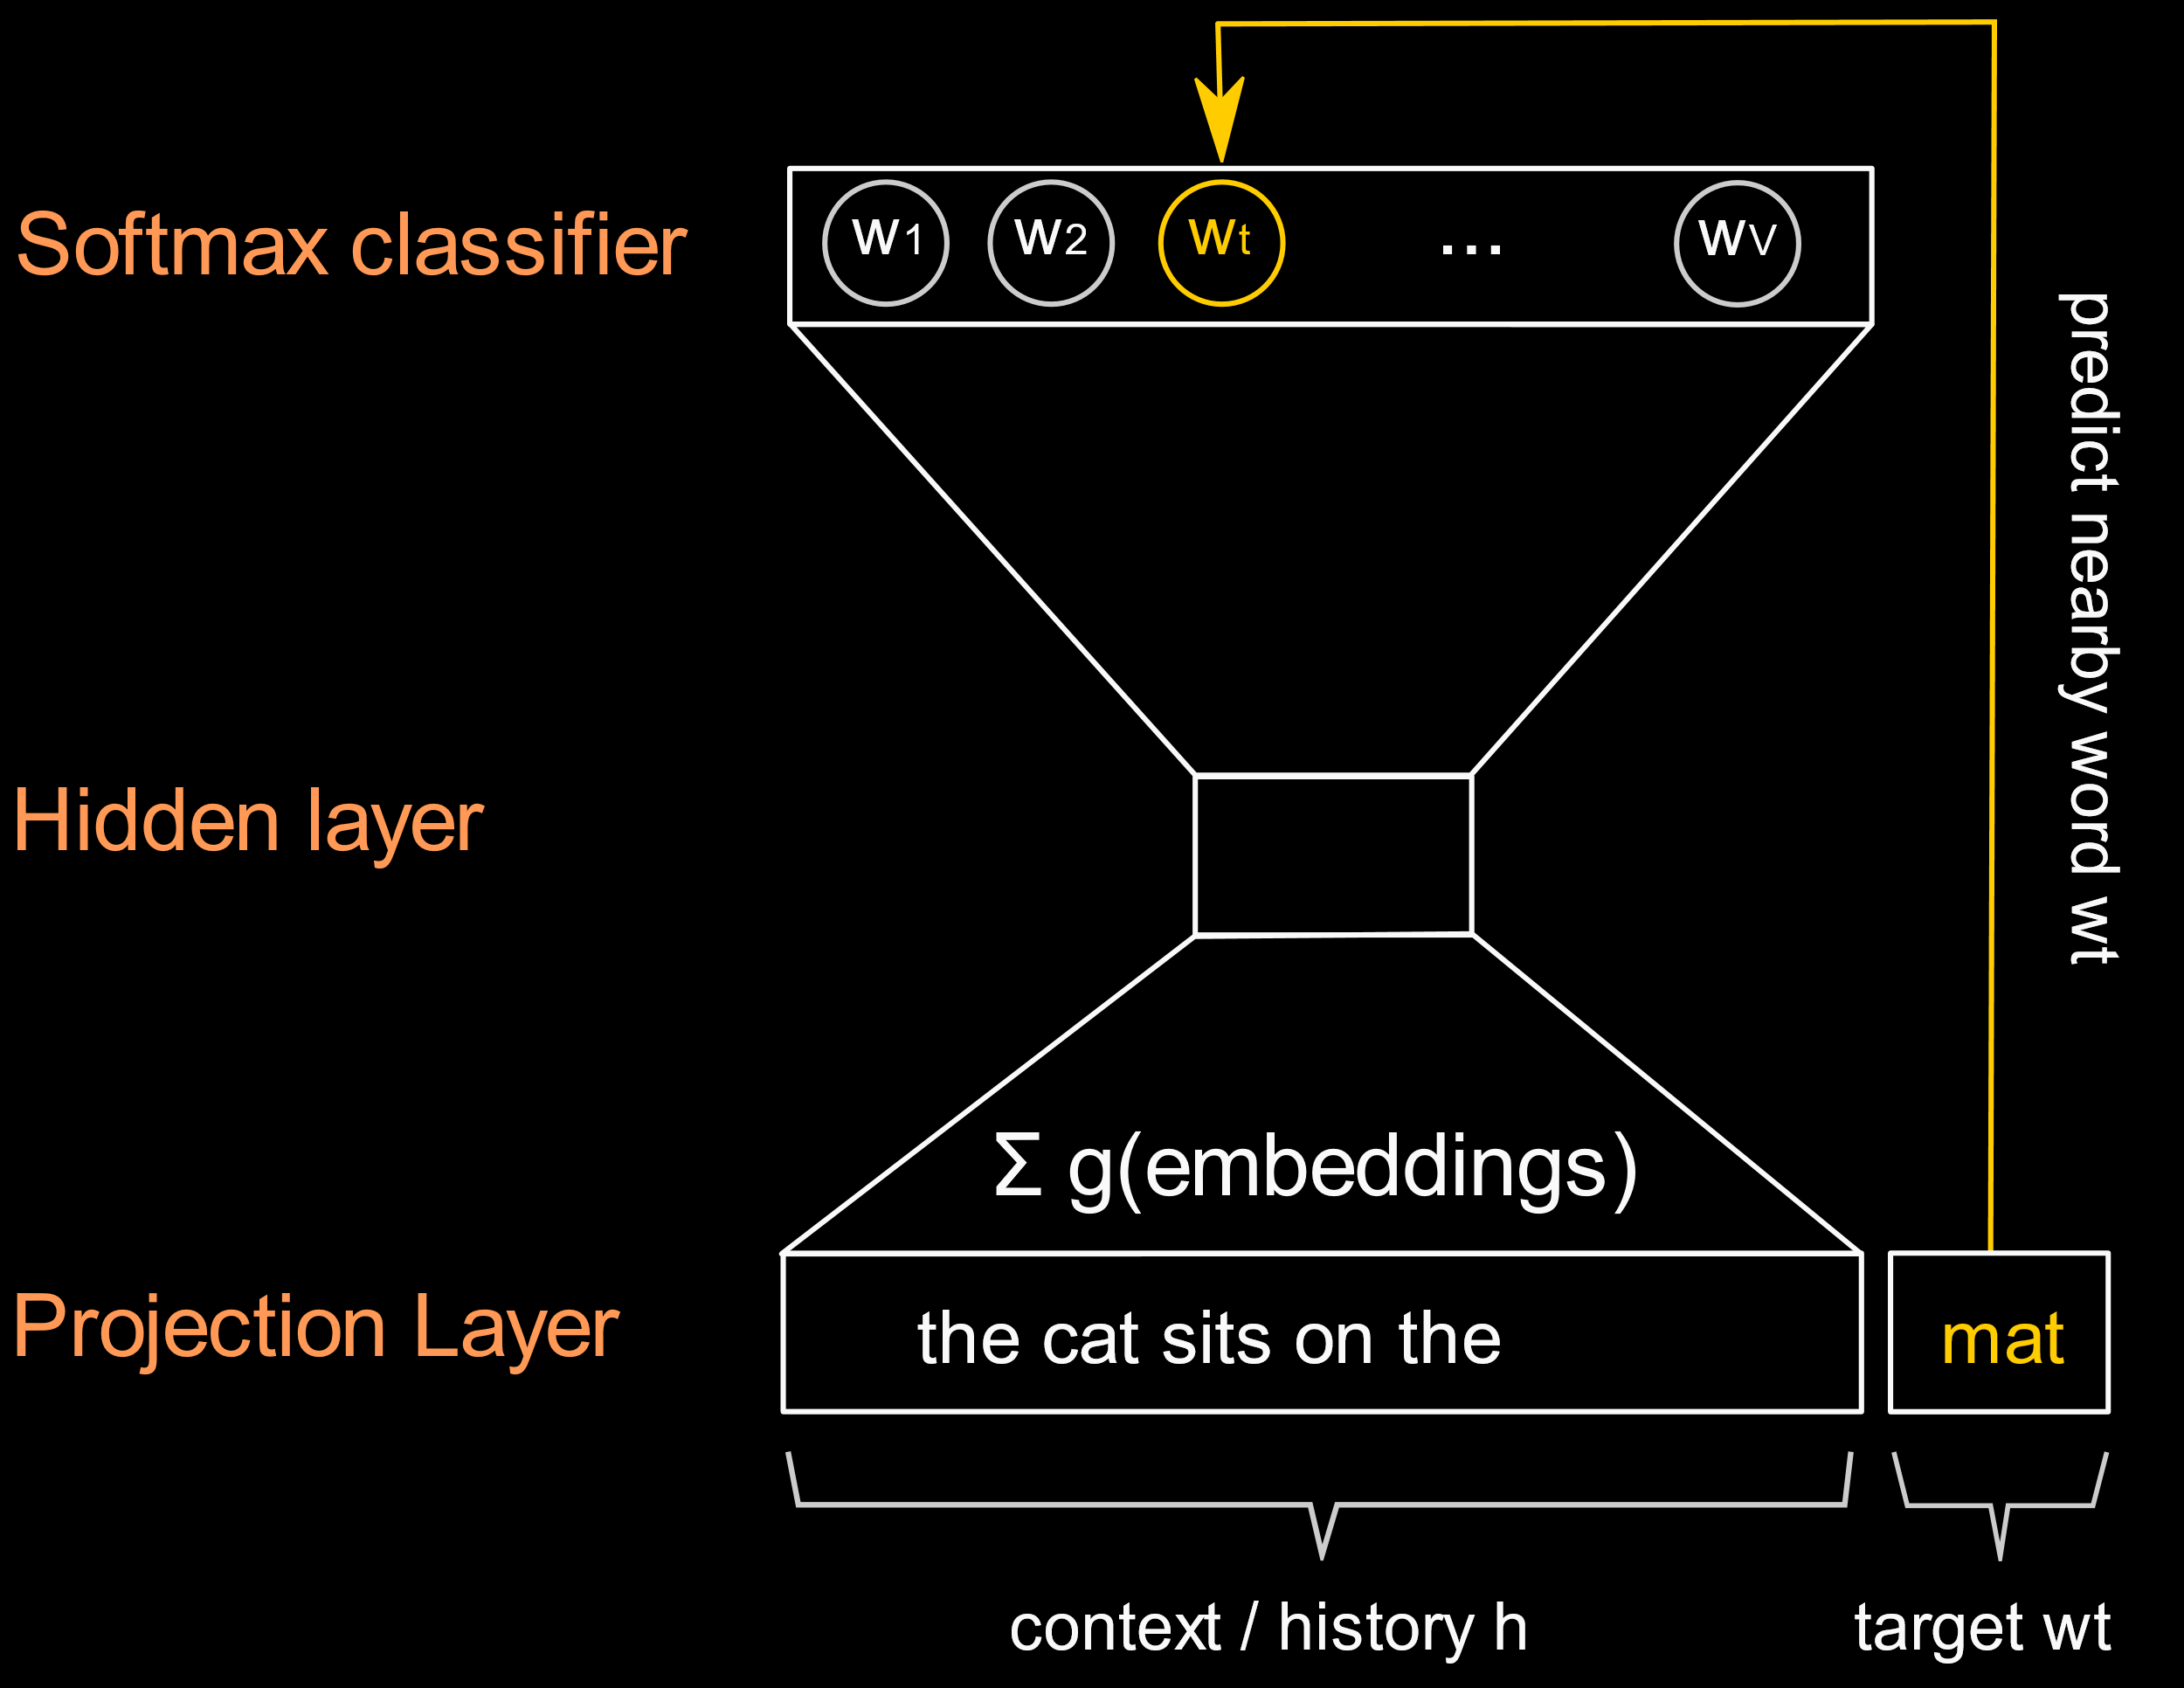
Evaluating distributional internal models
Problem: Sparsity of the input
Extreme for single responses
Moderate for continued responses?
External Language model benchmark
Count model: PPMI word co-occurrences
Prediction model: continuous bag of words (word2vec, Mikolov et al)

Slide 41
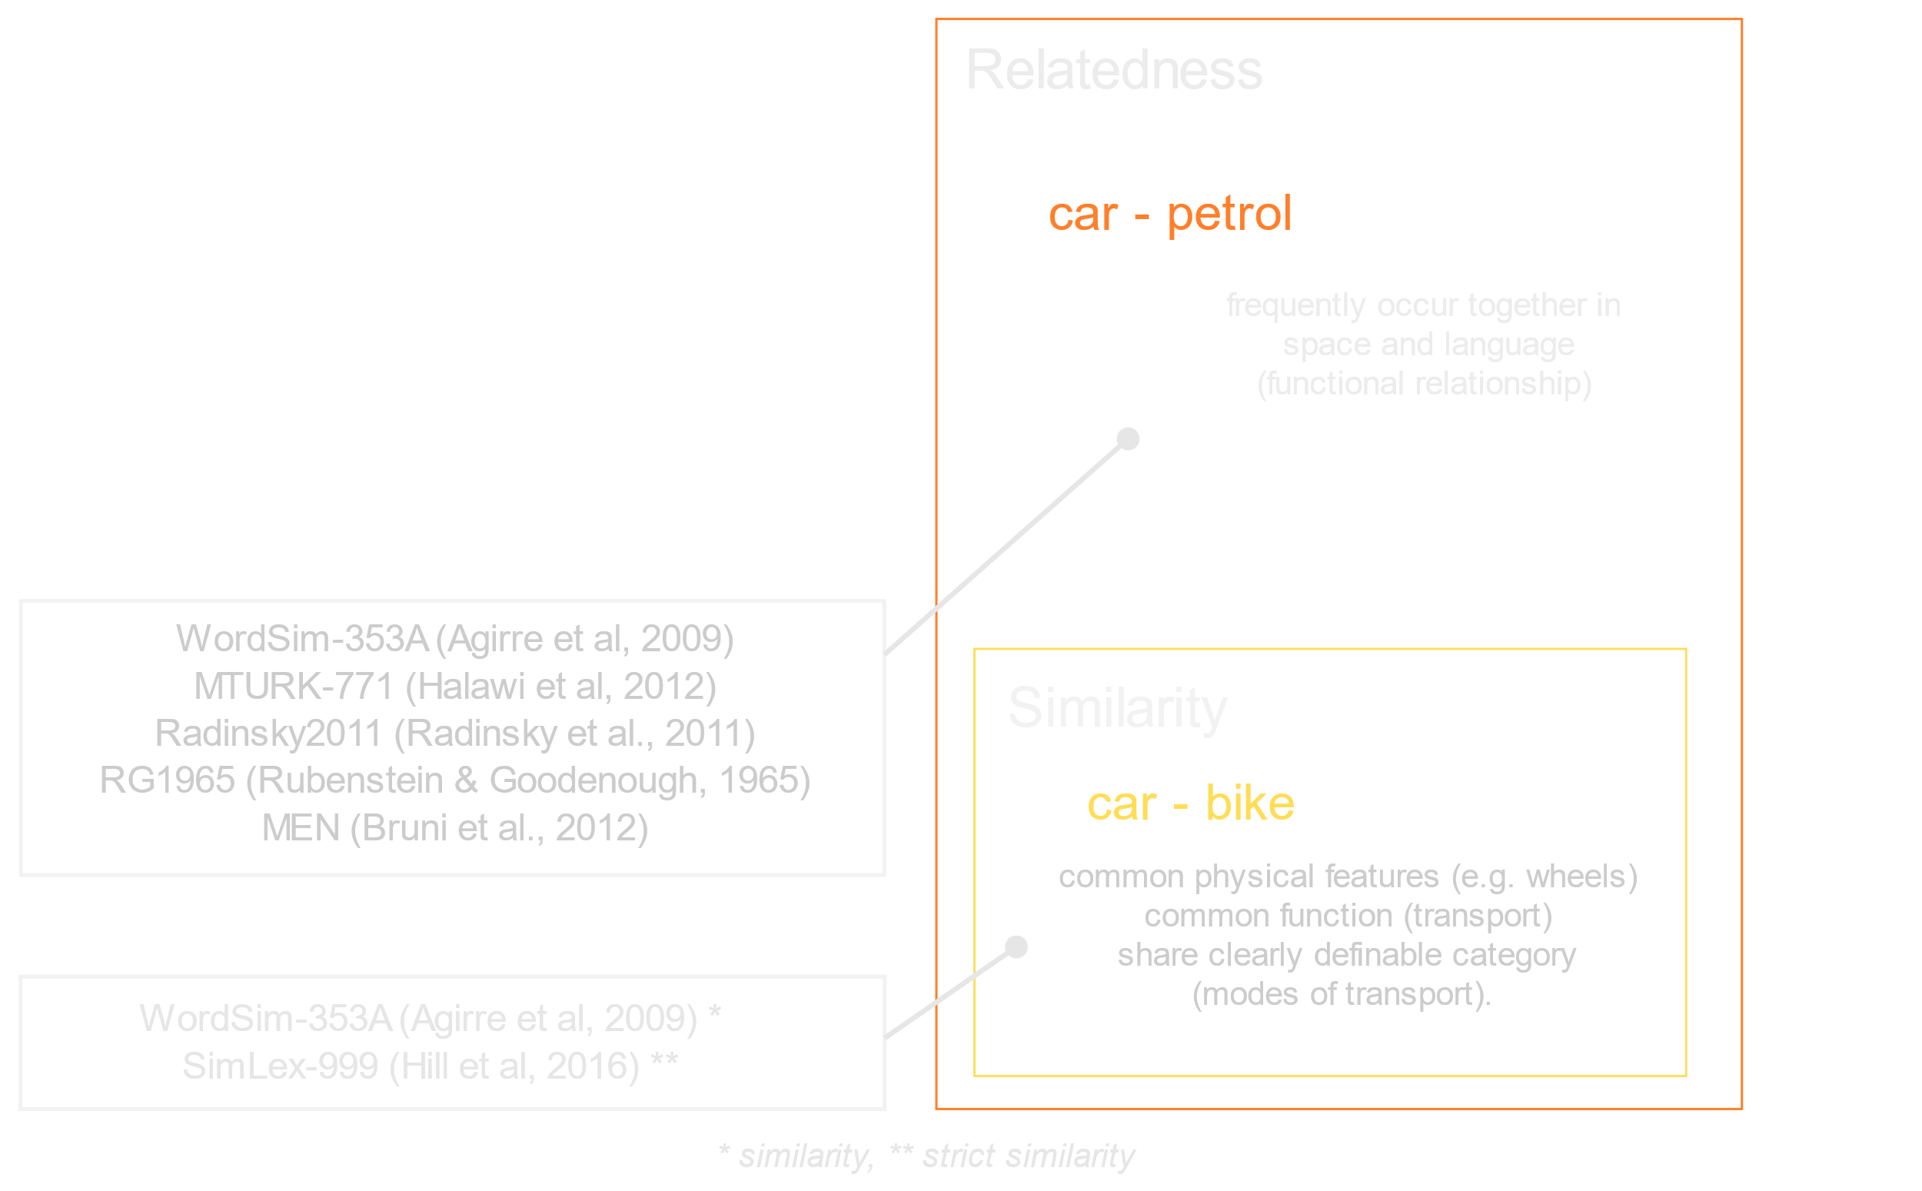
Evaluation
Model parameters
External Language Corpus models
PPMI: window-size: 3
w2v: window-size: 7
w2v: 400 dimensions
Internal Word Association models
RW: α=.75
Similarity and relatedness

Slide 42
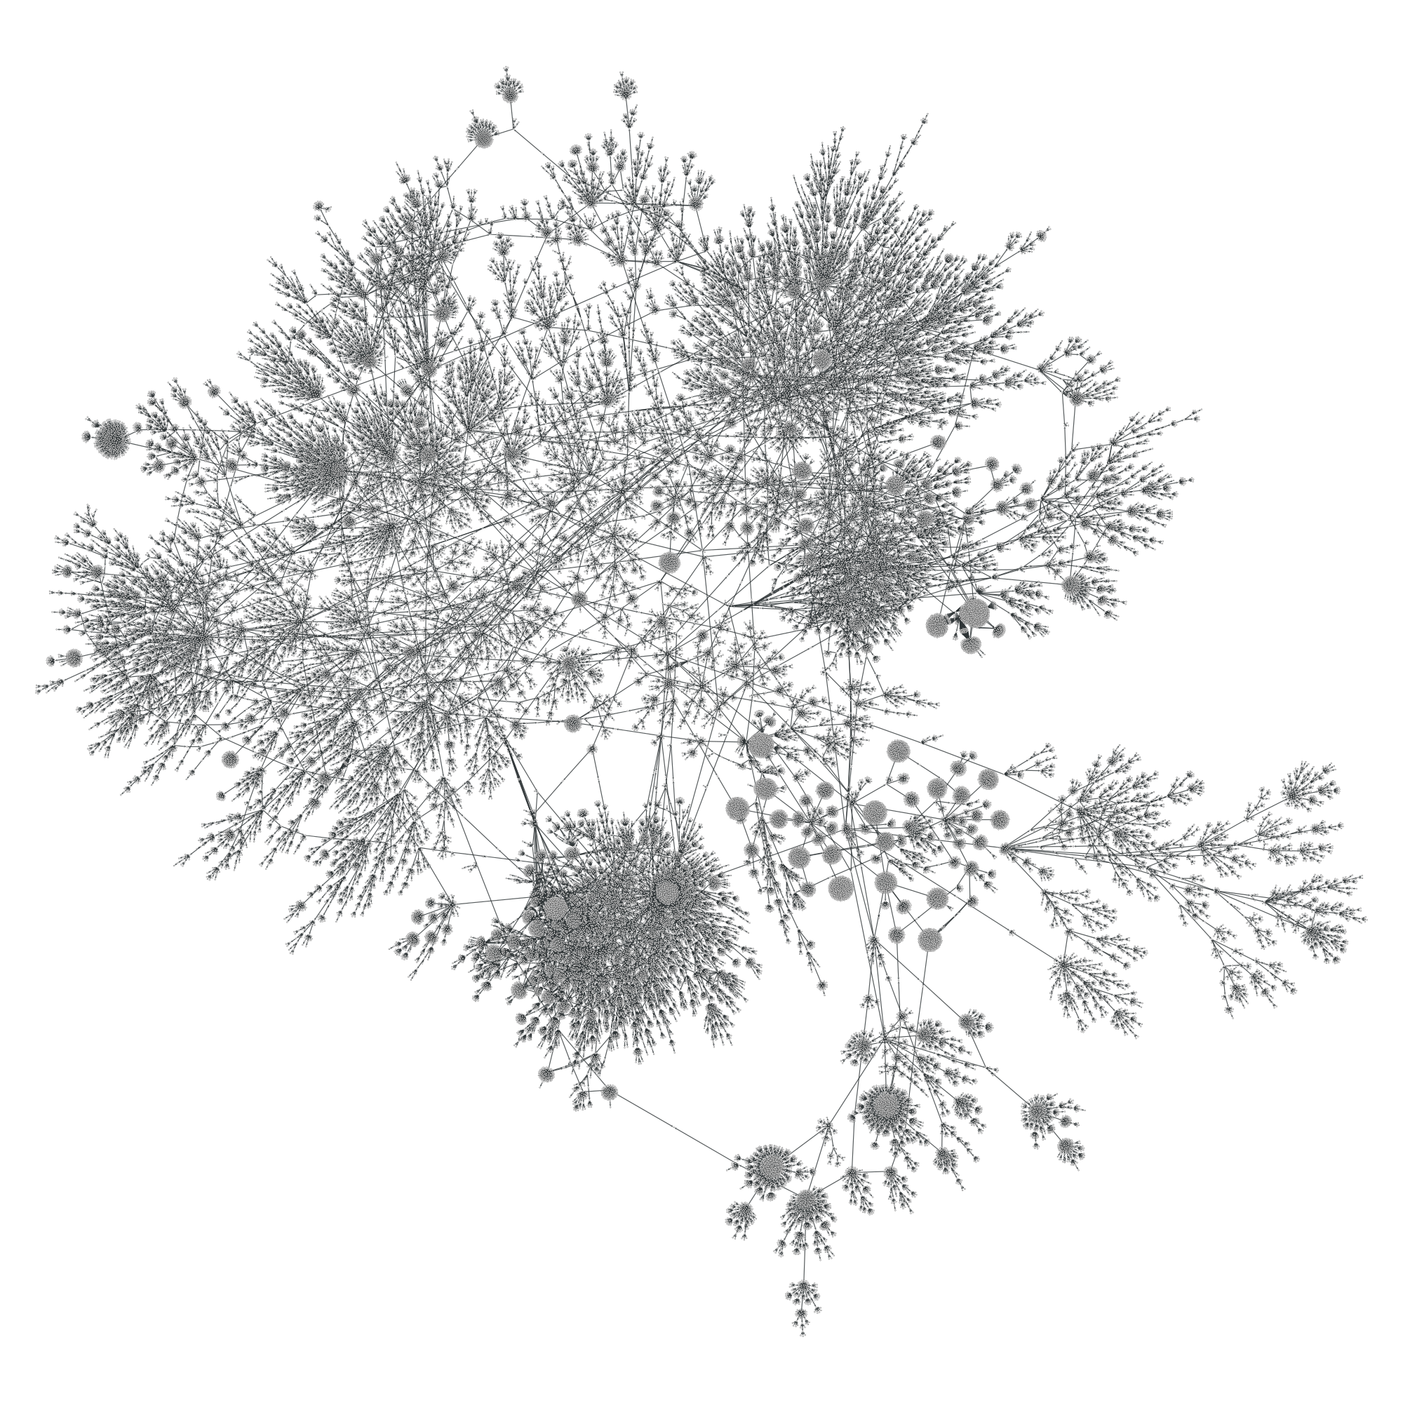
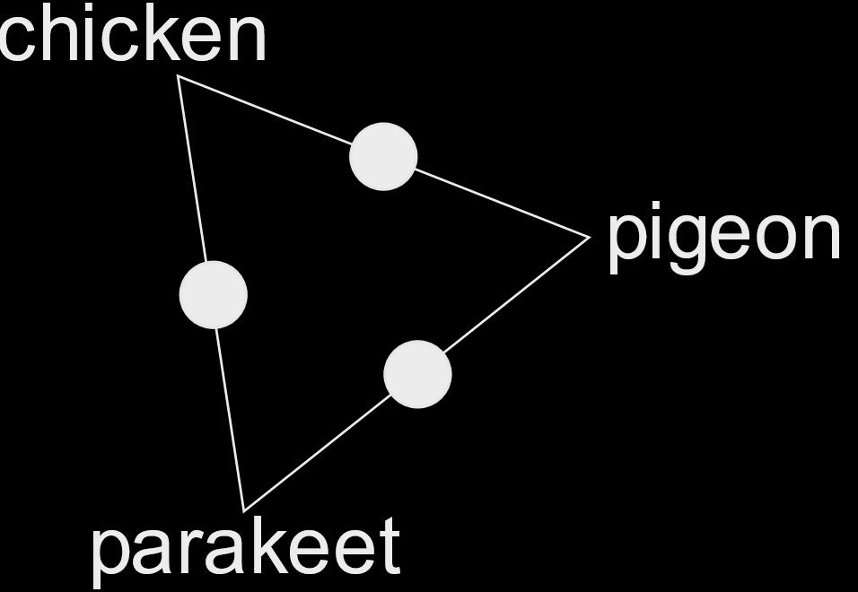
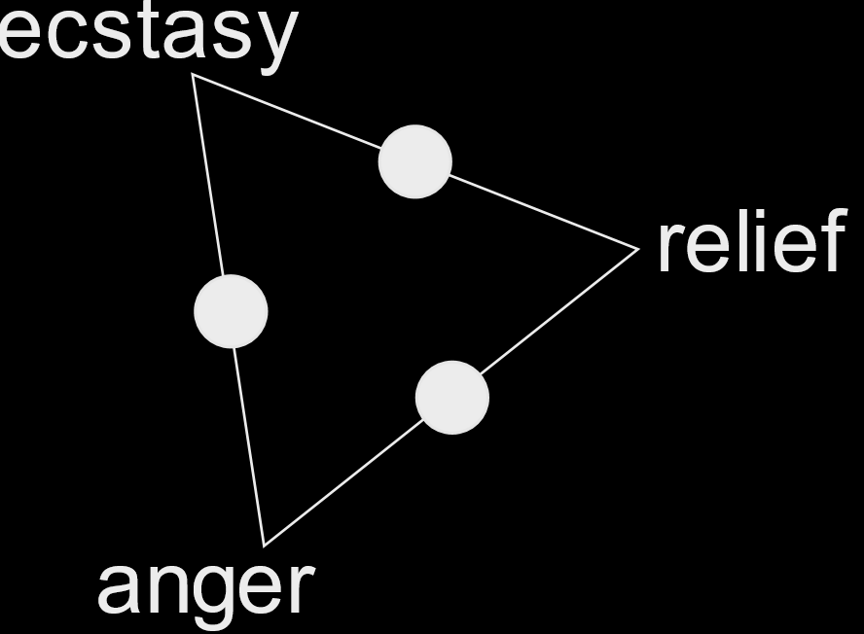
Basic Level Triads
Two ideas
Basic level concrete categories: most informative taxonomic level, predominantly perceptual and early acquired (Rosch et al. 1976)
Basic level abstract categories: no perceptual info, but meaning acquired through grounding internal affective states (Vigliocco et al, 2009)
Concrete basic triads
100 unique items
categories: fruit, tools, insects, ...
Abstract basic triads
100 unique items
categories: feelings, states, ideas, sciences, ...
Notes:
We choose basic level categories as a more challenging task here.
Basic levels for abstract categories were a bit more difficult to determine, we used wordnet.

Slide 43
Results
 |  |  | Linguistic Model |  | Word Association Model
 | n | n(overlap) | Count | w2v | Count | RW
Similarity Judgements
WordSim-353B | 203 | 175 | .74 | .79 | .84 | .87
SimLex-999 | 998 | 927 | .37 | .43 | .70 | .68
Relatedness Judgements
WordSim-353A | 252 | 207 | .67 | .70 | .77 | .82
MTURK-711 | 778 | 771 | .67 | .71 | .81 | .83
Radinsky2011 | 287 | 137 | .75 | .78 | .74 | .79
RG1965 | 65 | 52 | .78 | .83 | .93 | .95
MEN | 3000 | 2611 | .75 | .79 | .85 | .87
Remote relatedness judgments
Remote triads | 300 | 300 | .65 | .52 | .62 | .74
Average |  |  | .67 | .69 | .78 | .82

Slide 44
Discussion
Overall performance
Word associations:
Excellent predictions considering attenuation by unreliability
Only exception: “pure” similarity judgments (SimLex)
(Poor predictions for direct association)
Linguistic models:
Consistent improvement for prediction models, except for remote pairs
Published vectors
SNAUT (Mandera et al., 2016), r = .69
GloVe (Pennington et al, 2014)
6B tokens, r = .64
64B tokens, r = .67
840B tokens, r = .70
De Deyne, Perfors, & Navarro (2016)
Notes:
Maybe use a table for this?
Also, SimLex, still much better than literature (see paper Guillem, r
= .53

Slide 45
Why language networks…
Multiple levels of analysis: structure at every scale (local – global)
Complex networks: more is different: levels tell a distinct story
Multiple relations: interactions between syntax, morphology, phonology and semantics
Networks as a tool in quantitative linguistics: often simplification, but scale + transparency
Notes:
Why language networks
Multiple levels of analysis: structure at every scale
Complex networks: more is different: all levels tell a story
Multiple types of relations: interactions between syntax, morphology, phonology and semantics
Networks as a tool in quantitative linguistics: often simplification, but scale + transparency

Slide 46
My collaborators
Belgium: Gert Storms, Steven Verheyen, Guillem Collell, Marc Brysbaert
Australia: Andy Perfors, Danielle Navarro
SWOW-team: Francesca! Maria!
Australian Research Council
Questions - simon.dedeyne@adelaide.edu.au
Data - https://smallworldofwords.org/project/
Online study - https://smallworldofwords.org/

Slide 47
Selected readings
Baronchelli, A., Ferrer-i-Cancho, R., Pastor-Satorras, R., Chater, N., & Christiansen, M. H. (2013). Networks in cognitive science. Trends in cognitive sciences, 17(7), 348-360.
Biemann, C., Krumov, L., Roos, S., & Weihe, K. (2016). Network motifs are a powerful tool for semantic distinction. In Towards a Theoretical Framework for Analyzing Complex Linguistic Networks (pp. 83-105). Springer.
Stella, M., Beckage, N. M., Brede, M., & De Domenico, M. (2018). Multiplex model of mental lexicon reveals explosive learning in humans. Scientific Reports.
Steyvers, M., & Tenenbaum, J. B. (2005). The Large‐scale structure of semantic networks: Statistical analyses and a model of semantic growth. Cognitive science, 29(1), 41-78.
Watts, Duncan J.; Strogatz, Steven H. (1998). "Collective dynamics of 'small-world' networks". Nature. 393 (6684): 440–442.

Slide 48
Tutorial
Entirely optional: You can follow along in RStudio.
install.packages(‘devtools’)
library(devtools)
install_github(‘SimonDeDeyne/workshop’)
Caveat: This is work in development and might not work!

